Slide 2
THE POINT
Notes:
Per state law, The Point has a mandate:
•Maximize JOB CREATION and facilitate a HIGHLY TRAINED WORKFORCE
•Promote a high QUALITY OF LIFE for residents in and surrounding the state land
•Strategic RESIDENTIAL AND COMMERCIAL GROWTH that matches workforce needs
•Preserve NATURAL LANDS and enhance RECREATIONAL OPPORTUNITIES
•Improve AIR QUALITY and minimize RESOURCE USE
•Plan for future TRANSPORTATION INFRASTRUCTURE and other investments to enhance mobility and protect the environment
•COMPLEMENT DEVELOPMENT on surrounding properties
•Attract NATIONALLY RECOGNIZED RESEARCH CENTER

Slide 3
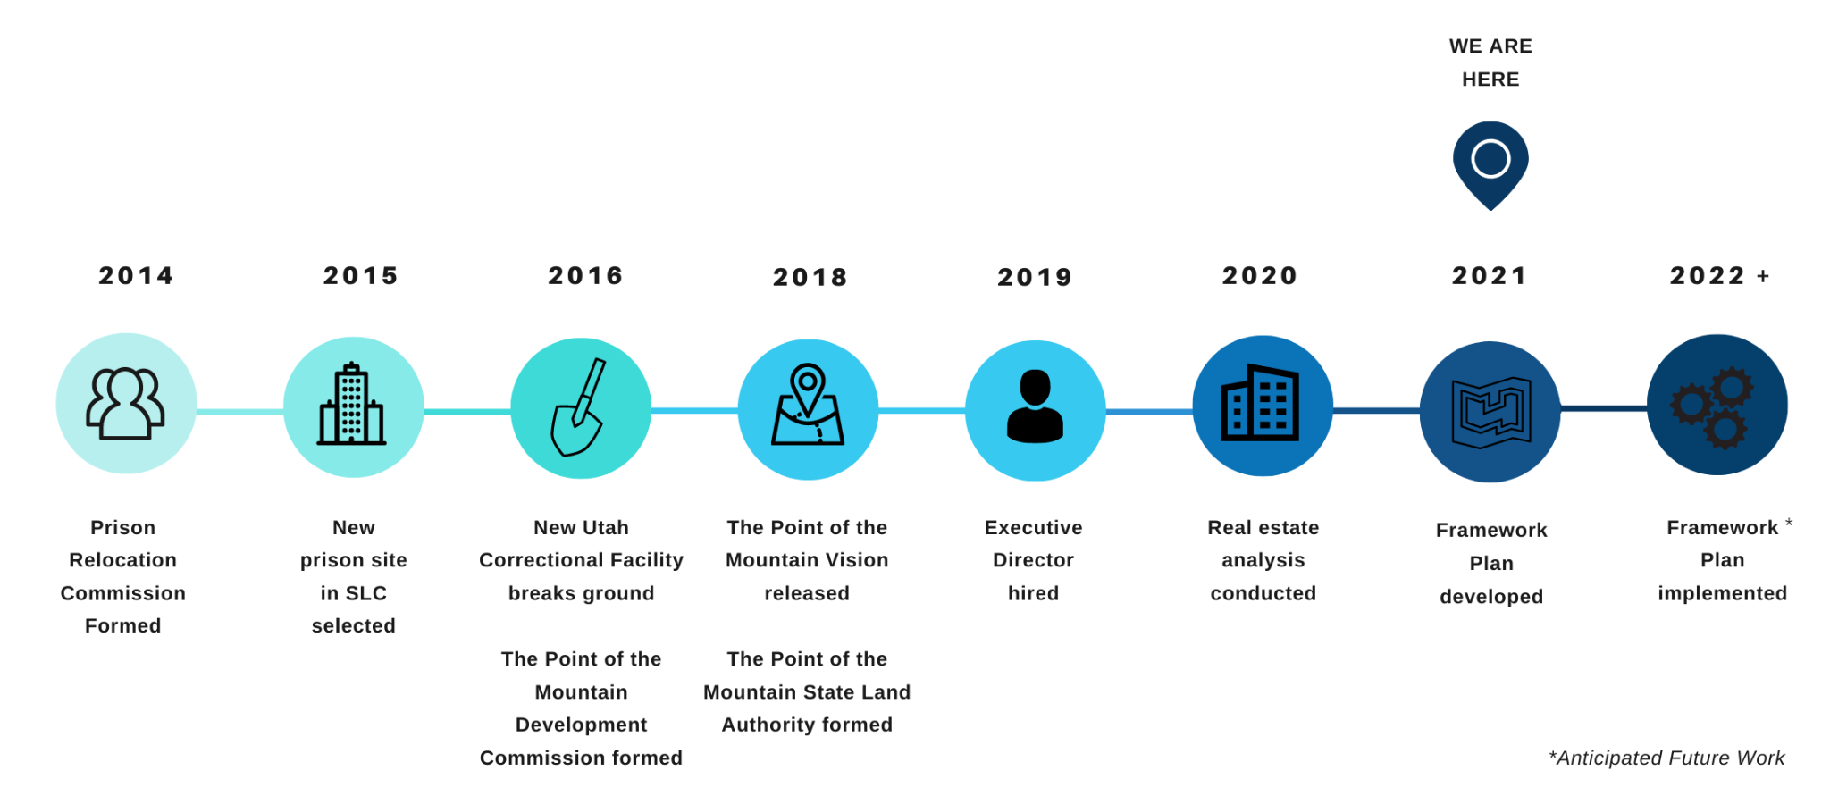
TIMELINE
Notes:
The Point didn’t happen overnight
Years of proactive planning and hard work by many stakeholders

Slide 4
The People

Slide 5
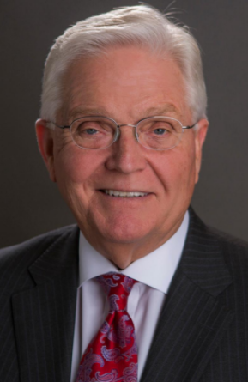
THE CO-CHAIRS
Lt. Governor
Deidre Henderson
Representative V. Lowry Snow
Notes:
The Point of the Mountain State Land Authority is an 11-member board composed of state legislators, agency executives, local elected officials, and business leaders. The board meets monthly, with all meetings being open to the public and opportunities for public comment at every meeting.
The Point of the Mountain State Land Authority recognizes their role as a trusted steward of public resources.
The Point will not be sold to the highest bidder.

Slide 6
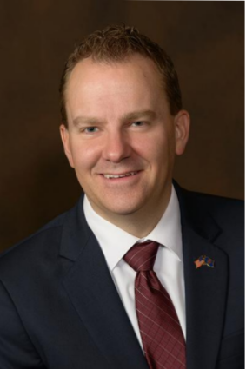
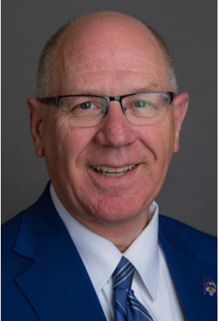
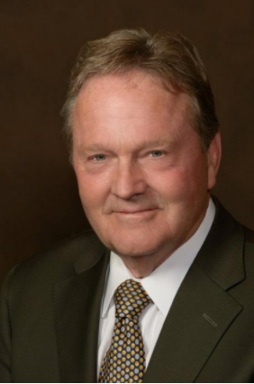
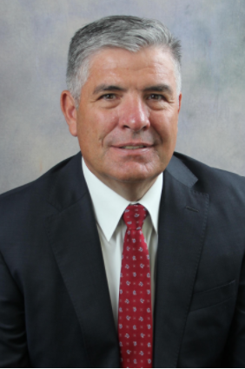
THE BOARD
April Cooper
Lincoln Fillmore
Stephen Handy
Dan Hemmert
Dawn Ramsey
Jim Russell
Jerry Stevenson
Troy Walker
David Woolstenhulme

Slide 7
GUIDING PRINCIPLES
Promote the Public Interest
Set the Standard
Think Regionally
Take the Long View
Be Open and Transparent
Act with Integrity
Notes:
Board guiding principles provide direction for all of our work.

Slide 8
The Public
Notes:
The Point is owned by all Utahns and all Utahns will continue to have meaningful opportunities to participate in planning the site.
Utahns are part of the decision-making process and public input is foundational to our work.

Slide 9
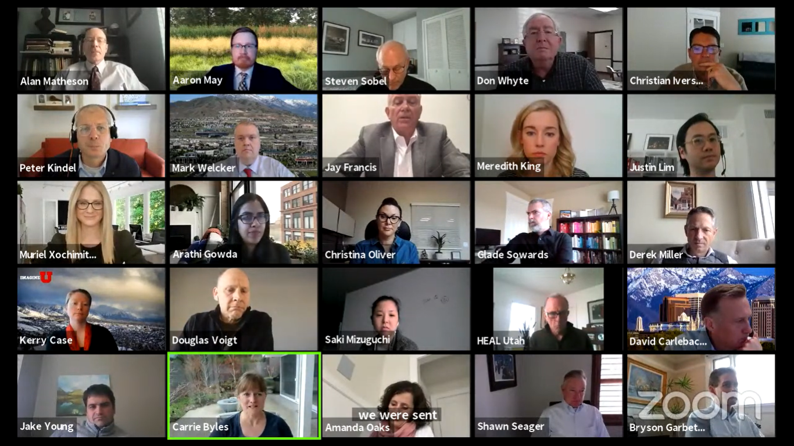
WORKING GROUPS
1
Stakeholder
2
Education, Research & Innovation
3
Environment & Air Quality
4
Infrastructure & Land Use
5
Economic Development, Recruitment & Investment

Slide 10
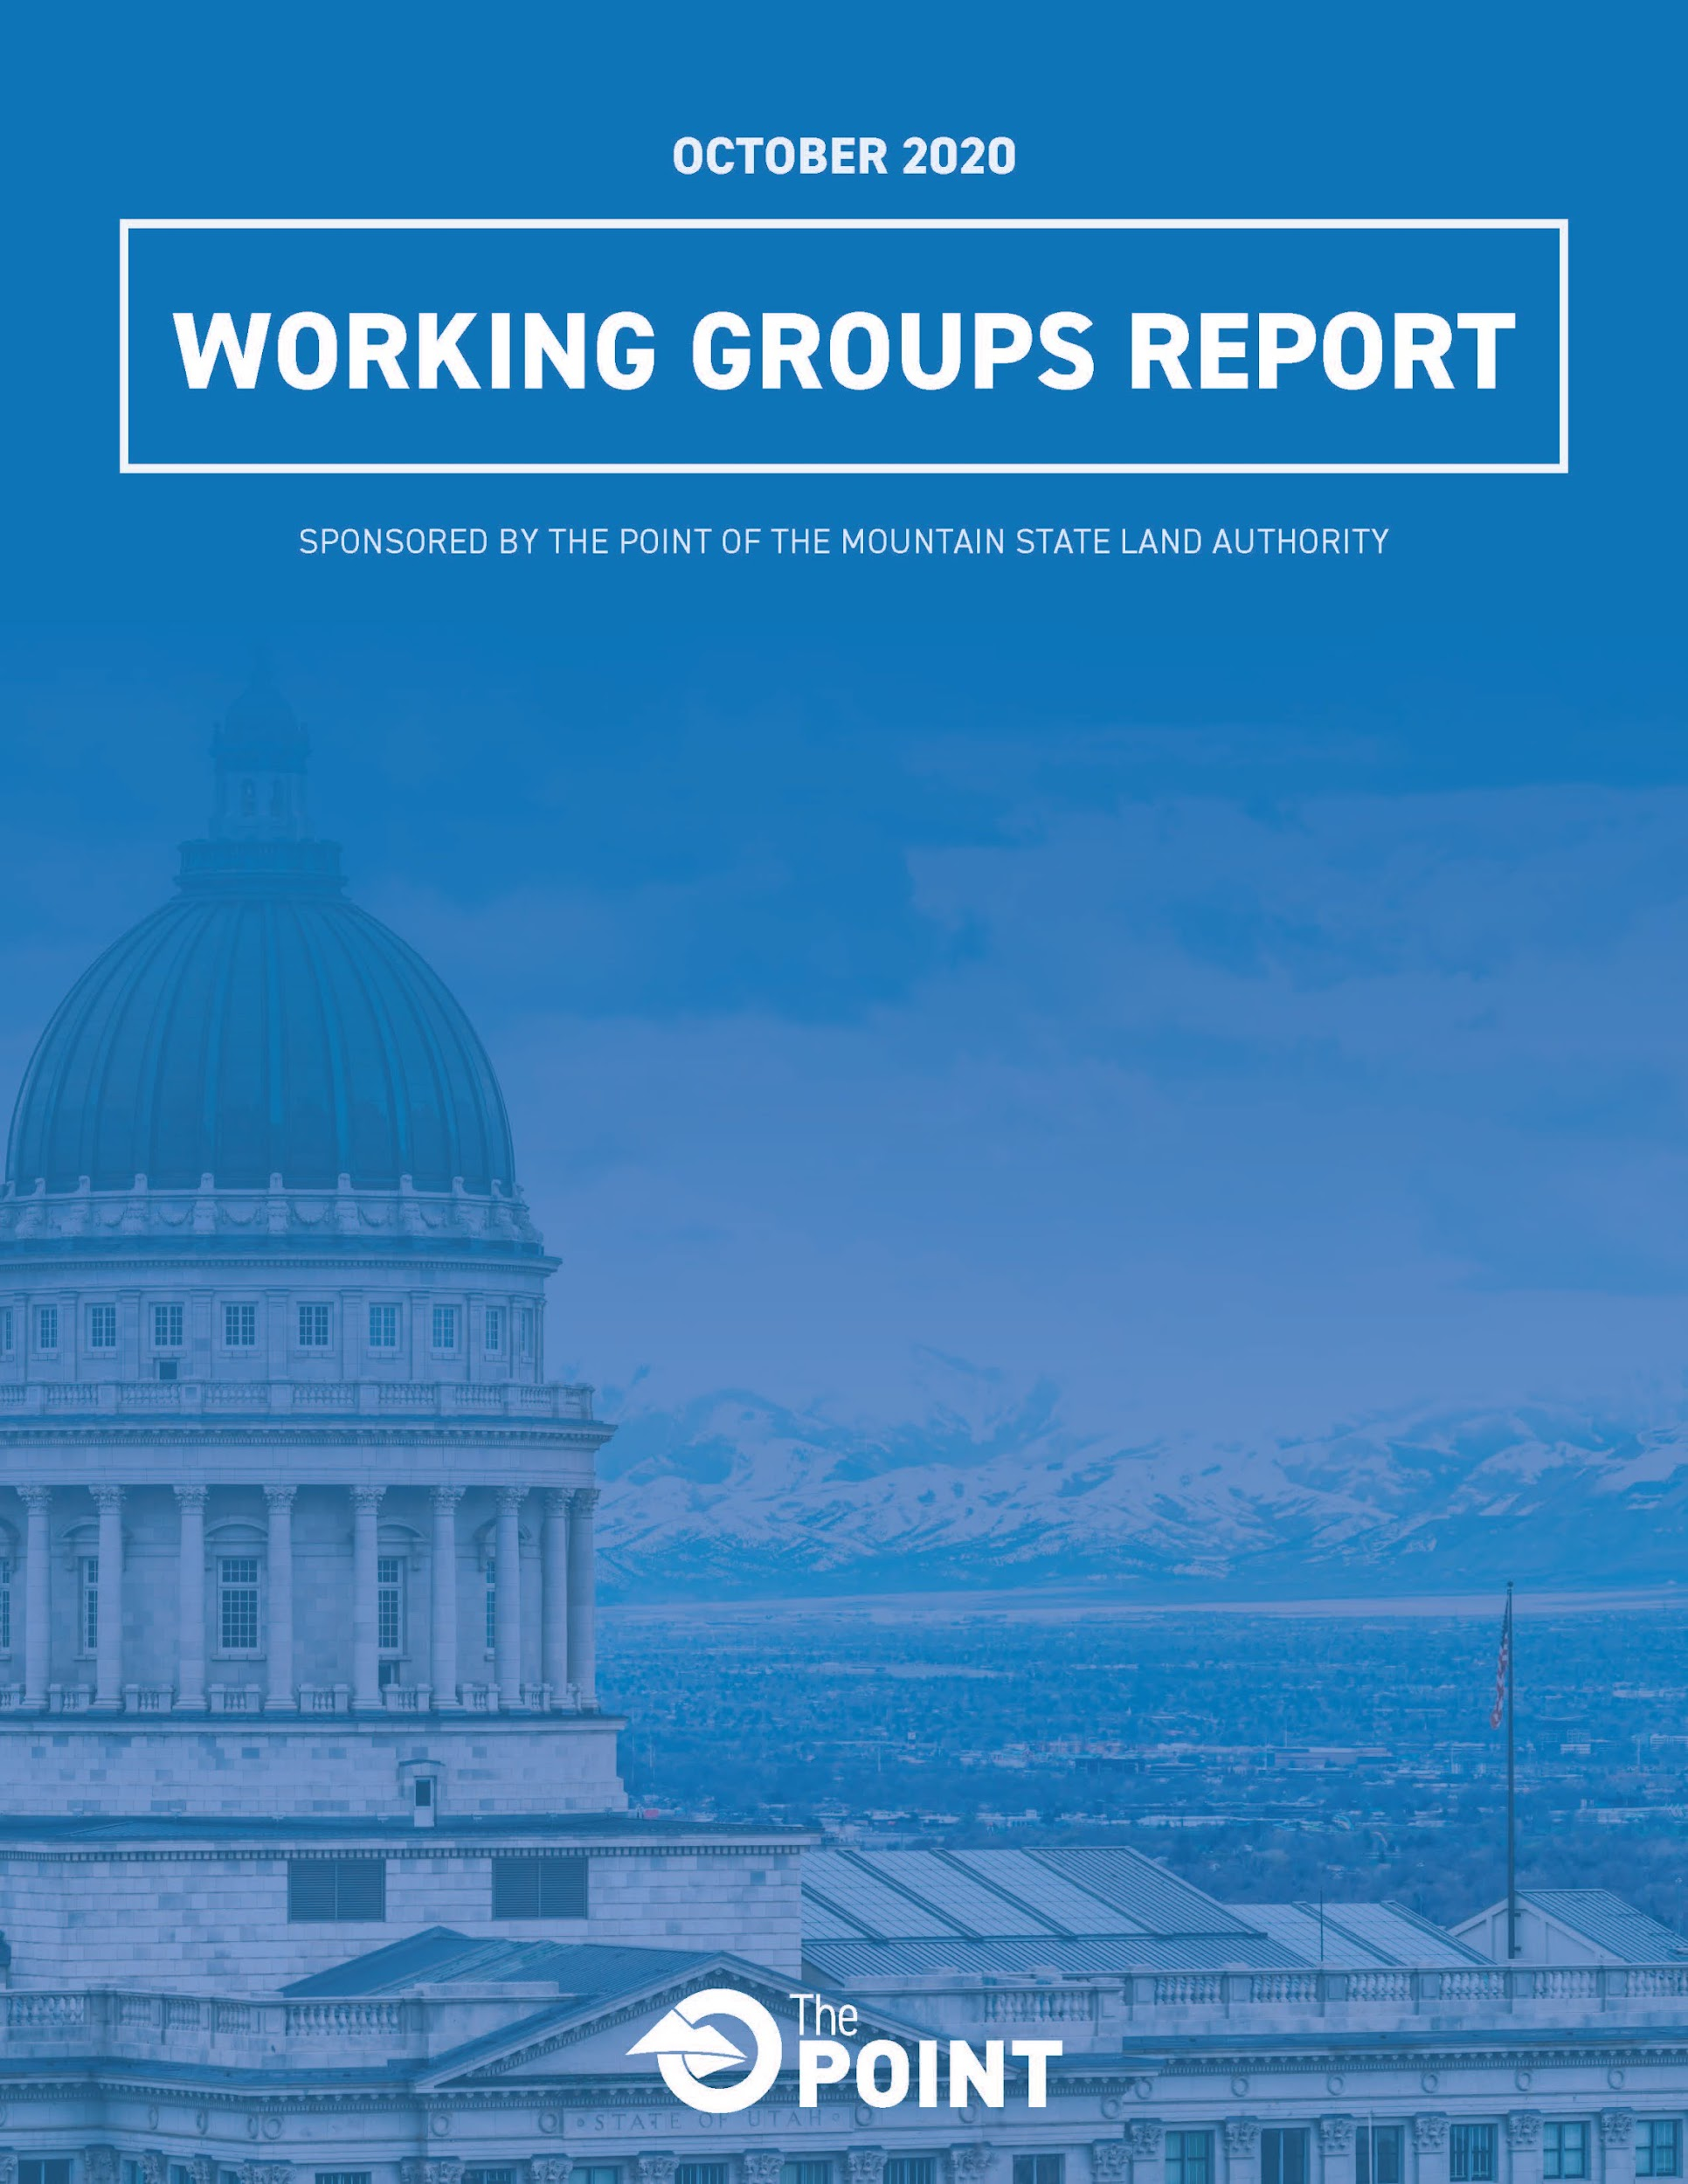
KEY VISION ELEMENTS
Notes:
Working groups released a report (available on website)
Identified 6 Key Vision Elements
KVEs informing direction for the framework master plan

Slide 11
STAKEHOLDER ADVISORY COMMITTEE
Notes:
Collaboration is a key ingredient of Utah’s secret sauce. We are committed to working closely with local communities, businesses, organizations and other stakeholders to ensure the best outcomes.
Stakeholder Advisory Committee members represent broad perspectives.

Slide 12
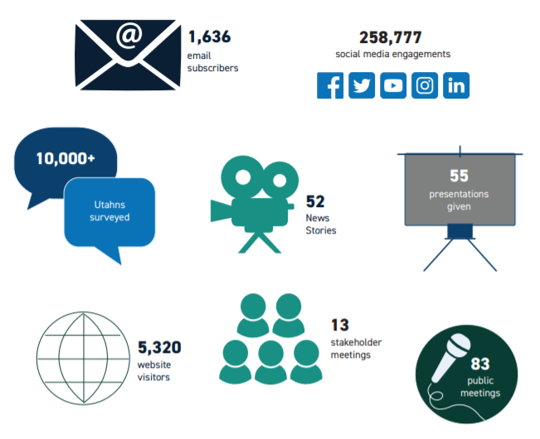
OVER 10,000 UTAHNS

Slide 13
The Plan

Slide 14
FRAMEWORK PLAN TIMELINE
Notes:
INITIAL SCOPING
conduct thorough site evaluation
research the site's history
assess the results of prior public input
assemble existing plans and studies of the site and surrounding areas
perform transportation, land use and economic development modeling
Identify opportunities and constraints.
SCENARIO DEVELOPMENT
create concepts that identify different possible approaches to future development.
Sophisticated analytical tools will reveal how the scenarios will perform relative to key economic and quality-of-life measures.
Public input will be seriously considered when evaluating various scenario components such as urban design, transportation and other infrastructure, parks and trails, recreation, shopping, housing, office space and much more.
PREFERRED ALTERNATIVE
Combine the best elements of the scenarios to create a preferred alternative
may include a combination of components from all or some of the different scenarios
Refine the preferred alternative to optimize performance
goal of identifying strategies that best meet key performance goals
FINAL PLAN
Create a final master plan and development guidelines
Framework for development, with built-in flexibility to accommodate changes in future market conditions, public input, and other variables

Slide 15
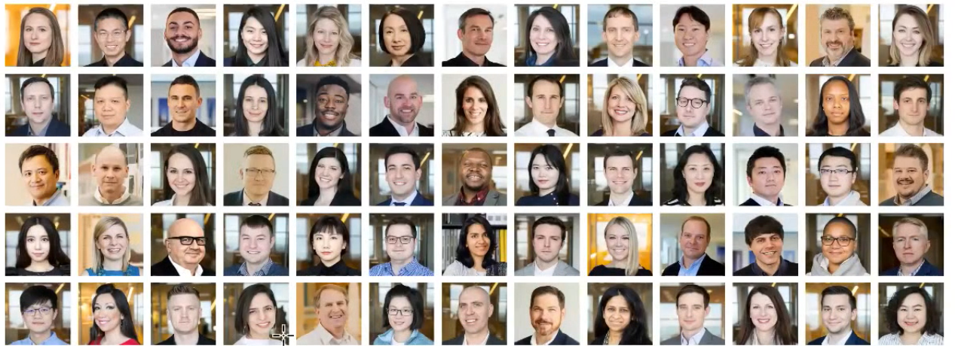
WORLD-RENOWNED FIRM
Notes:
Through a transparent, competitive selection process, The Point of the Mountain State Land Authority selected an internationally recognized planning firm, Skidmore, Owings & Merrill (SOM) as the lead firm to create a master plan for The Point.
The announcement comes after a months-long competitive process to solicit proposals from internationally recognized planning firms.
SOM is one of the largest and most influential architecture, interior design, engineering and urban planning firms in the world.
They are known for designing some of the most technically and environmentally advanced buildings and significant public spaces.
SOM’s interdisciplinary team of global and local experts include some of the best and brightest minds in the industry.

Slide 16
MULTI-DISCIPLINARY
Notes:
SOM is a multi-disciplinary firm
Integrated planning model means we’re getting the best and brightest from all fields

Slide 17
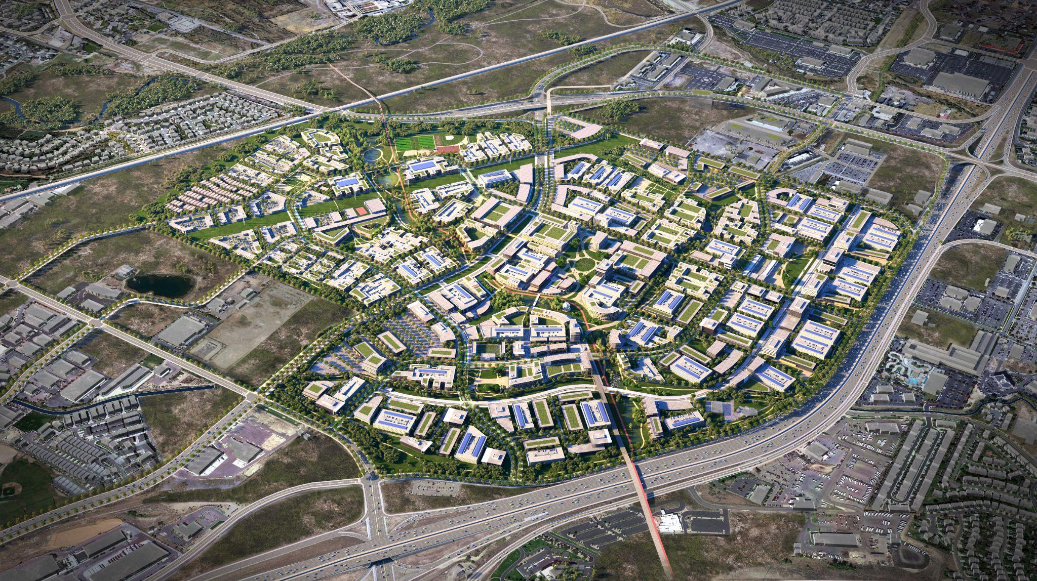

Slide 22
CONTACT US
www.thepointutah.org
info@thepointutah.org
801-214-1631
P.O. Box 692 Draper, UT 84020
@thepointutah.org
Notes:
We have a dedicated communications team.
Don’t hesitate to get in touch with us.
Many different ways to comment, ask questions, etc.

Slide 23
Plan The Point
Utah’s Generational Opportunity
Alan Matheson
The Point Executive Director

