Slide 1


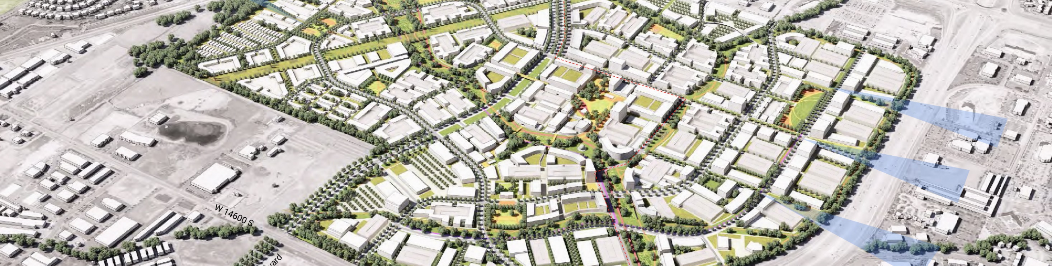
The Point – Project Enhancements Analysis
Board Presentation
3/8/22
+
Notes:
Thank you for the opportunity to present. We’ve been working on these studies for many months and are excited about the opportunity to make the aspirations of the point a reality. Before I go further I’d like to our consultants AECOM and Sam Schwartz for their support – these are worldclass firms that brought worldclass ideas. And also to Steve Kellenberg who’s in Greece at the moment, and who’s been really key in helping throughout the process as well as Erin Talkington.
I recognize your time is valuable and limited. Which presents a challenge to summarizing these studies which are found in over 300 pages of reports forthcoming this week, covering technical material, on an extensive set of what we call project enhancements or strategies for smart mobility, smart technology and sustainability on the project.
Today what we want to accomplish is share the strategies our consultants have identified and which we feel best align with the framework plan goals, and the associated cost / benefit trade-offs. And I’ll do that by presenting summarized scenarios that to varying degrees meet the framework plan goals, along with some approaches to paying for those strategies, including a scenario we feel pretty confident we can implement, but may require some investment through land value subsidy and others that we are optimistic may allow us to expand the strategies and benefits but require more analysis on governance and financing options. And so our request is for your feedback as to whether we’re on the right track and your approval to continue additional analysis on how these strategies can be operationalized.
I should note a critical dependency before selecting a final program is the selection of a master development partner who we’ll need to collaborate with in determining investment options and feasibility of the scenarios. We had initial conversations around support for the enhancements in phase 1 of the RFP process, which we were encouraged by, but will need to dive into the details with them; and leverage our financial consultant Zion Public Finance in that process.

Slide 2

Framework Plan Goals

Slide 3

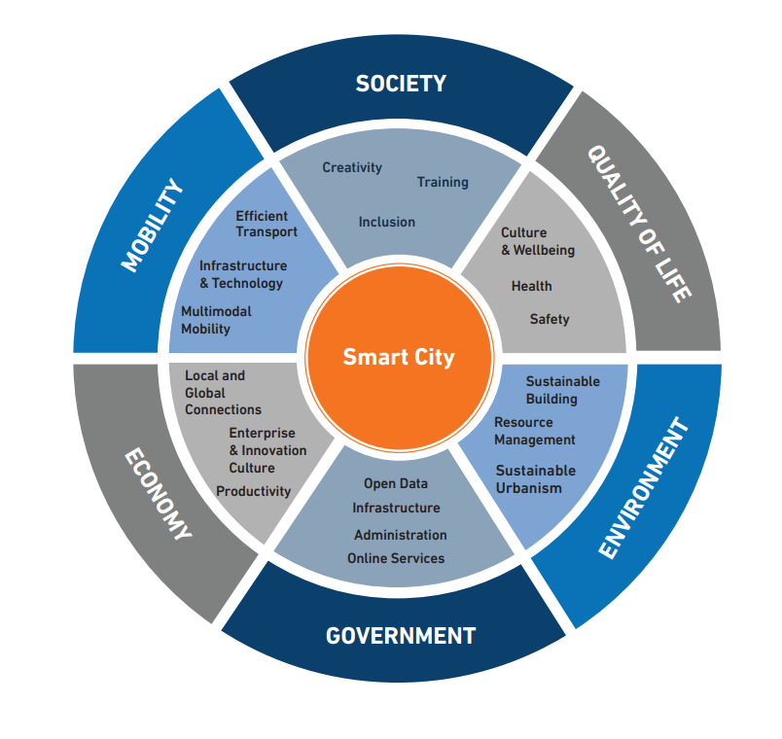
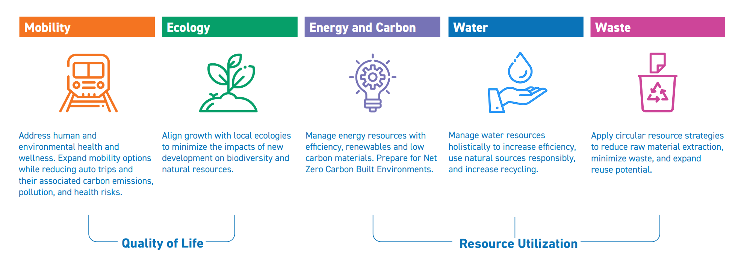
The Vision and Mandate
Key Vision Elements
+
Sustainability Core Elements
Smart City Aspirations
Notes:
As you know we have a mandate to be a model for smart growth and to deliver on what Utahns expressed they want with the land which belongs to them and those aspirations were captured in our framework plan and our statute. These studies help us take a step further to making those ambitions a reality as they relate to smart mobility, sustainability and smart city technology.

Slide 4



Performance Goals
CARBON
ENERGY
0%
Net Carbon by 2050
-20%
Embodied Carbon
Maximized
Electric
50%
Renewables
Net Zero
Carbon
-50%
Less energy from the Grid
Adopted from Framework Plan
Goal modified from the Framework Plan
WHY?
A Net-Zero carbon community is considered the pinnacle of sustainable development in the context of the climate crisis. Leveraging the grid decarbonization efforts of Rocky Mountain Power, we think this is an achievable goal, especially by 2050 and beyond.
We’re aiming for a 50% reduction in energy consumption from the grid and a minimum 50% renewable energy goal. We’re not aiming specifically for Net-Zero Energy as Net-Zero carbon is deemed more important and Net-Zero Energy is not a necessary condition for Net-Zero Carbon.
Notes:
We evaluated the framework plan goals against the conditions of the site, and cost factors to determine optimal strategies; in some cases this meant we were able to achieve more than anticipated and in other cases less but all we’re now more informed and have a set of realistic goals tailored to the advantages and constraints of the project
Carbon – based on framework plan (50% less operational carbon is the framework goal and -20% embodied carbon (cost prohibitive) but can achieve near carbon neutral or carbon neutral given RMP’s grid decarbonization program which we’ll benefit from
Energy – 50% energy efficiency goal from framework plan; 50% grid reduction through energy efficiency (lighting fixtures, energy systems, efficient bldg. envelope etc.), and substantial use of solar; which along with heat pumps, electric water heaters, geothermal heat from district system help achieve a goal net zero or near net zero carbon – and it saves residents at the point money
Rio de Janeiro, New York, Paris, Oslo, Mexico City, Melbourne, London, Milan, Cape Town, Buenos Aires, Caracas, Copenhagen, and Vancouver.

Slide 5



Performance Goals
WATER
WASTE
-40%
Potable Water
>15%
Reuse
100%
Non-Potable Irrigation
50%
Waste Diversion
75%
Construction waste diversion
Lower Potable Water Use
Lower Everyday Waste
Potable Water Goal based on the Framework Plan; New Reuse and Irrigation goals
Adopted from the Framework Plan
WHY?
Water is a scarce resource in Utah and we’re aiming for a 40% reduction in use of potable water. Within the constraints of various water rights, we’re also aiming for a 100% of secondary water for irrigation that aligns with a goal of 15% reuse of water.
Keeping with the Framework Plan’s goals, a 50% everyday waste diversion or reduction, and a 75% construction waste diversion is proposed for ThePoint.
Notes:
Water – FW goals: 40% reduction in indoor water and 100% retention of stormwater on site and 100% surface run-off is naturally filtered; Water has never been a more precious resource in our state and is critical to our project’s success; we aim to acheive a 40% potable water reduction through more efficient fixtures (indoor and outdoor), AND go a step further to not use potable water for irrigation (using from waterpro), which also helps to achieve the 15% water reuse goal along with rooftop rainwater reuse
Waste – FW goals same; Waste diversion through Re-use (stroller example), Reduce (less printing, use digital), Recycle – restaurant, grocery, commercial programs, 3 bins (organic, trash, recycle); build waste diversion into dev agreement; and 75% construction waste diversion

Slide 6


Performance Goals
SMART CAPABILITY
VMT
50%
Of ‘Full’ Smart Capability
-25%
Vehicle Miles Travelled
Goal based on Smart City Aspirations
Adopted from the Framework Plan
WHY?
ThePoint is seeking to be a Smart District, keeping with its vision as Utah’s premier Innovation Community. We have defined an ideal smart district with full capabilities around smart ICT infrastructure, smart utilities, smart environment, smart community, and smart buildings. The goal is to realize at least half of the features of the Ideal.
ThePoint aims to be Utah’s first 15-minute Community and lower vehicle miles travelled is a direct result of that goal. A minimum of 25% reduction of VMT from a business-as-usual development is desired.
Notes:
Smart Capability – not well defined in FW; we compared against other projects and smart city certification programs including the INSPIRE program
VMT – FW plan was 1/3 but is not financially tenable or ridership realistic for a non-CBD site – tough to achieve anywhere in the country (UoU is about 30%; only 6% of SLC residents take transit to work)

Slide 7
Methodology

Slide 8
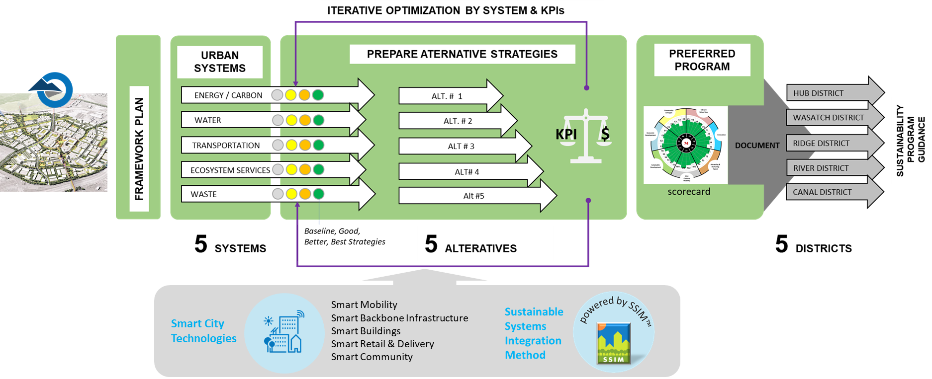
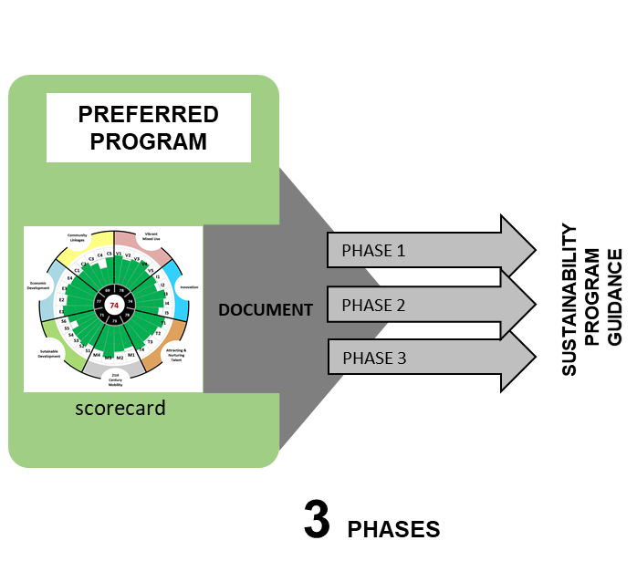
Sustainability Methodology

Slide 9
Measuring & Comparing Scenarios
Systems
Strategies
Measurements
Selected Scenarios
Performance Measures
Goal Optimized
Water
Energy
Carbon
Waste
Transportation
Ecosystems
Smart Systems
Baseline
Good
Better
Best
CapEx
Cost Optimized
OpEx
Smart Capability
Innovative
Notes:
Goal – This scenario attempts to maximize the number of goals achieved while keeping overall cost premiums <= 2% and simpler governance for how the strategies are managed; includes lower investment and lower ROI
Cost – This scenario meets or exceeds most goals while keeping within a +1.5% cost premium for commercial buildings but requires some investment comes out of the land value which is in essence a subsidy to the developer; achieves strong ROI
Innovative – This scenario meets or exceeds most goals while keeping within reasonable cost premiums to the developers and offers more features but requires an innovative financing and governance model – namely a utility association; but achieves highest ROI
ThePoint’s Utility Association is an entity created primarily to :
provide a centralized utility and sustainability services such as community solar, smart mobility and public realm connectivity, smart services such as the mobility and community app
provide governance, sustainability KPI tracking and maintenance of smart infrastructure including smart mobility in public areas
as a non-profit entity, raise capital and funds for investment at ThePoint (such as for community solar) and recover the investment through association dues and fees.

Slide 10

CapEx
What it includes
Who pays for it?
What are the Baseline Costs?
What are the Incremental Costs?
Capital Expenditures (CapEx) include initial investments in horizontal (utilities, roads etc.) or vertical Infrastructure (buildings and components), and other specialized assets such as smart kiosks, charging facilities etc.
In some cases, CapEx can include avoided costs as savings compared to Baseline costs.
State Land Authority
Land Developer
Vertical Developer
Utility Association
Private (Owner / Tenant)
Other (ESCO etc.)
These costs are what a typical development built-to-code will require. Costs have been calibrated to local economy and do not include soft costs. Using an accounting protocol – negative numbers denote costs while positive number show savings.
Incremental costs are costs over and above the baseline costs incurred as a result of implementing an innovation/sustainability measure not typically included in a business-as-usual setting. Incremental costs are measured in two ways -
% Cost Increment from Baseline
$ cost / square feet
We are using a threshold of 5% above horizontal baseline and 1.5% vertical baseline as a goal/guideline based on market acceptance.
Who pays and who benefits from the investment are important aspects to consider as they are not always the same. CapEx is necessary to deliver the vision, brand and associated sustainability performance
Notes:
Of course a key question when discussing project enhancements is who pays for them.
Compared baseline found in the framework plan to good, better and best scenarios and came up with associated incremental cost

Slide 11

OpEx
What is it?
Who pays / receives it?
What are the Incremental Annual Expenses and Savings
What is Net OpEx?
Operating Expenses (OpEx) include annual costs to operate various systems and include both Expenses to maintain and operate equipment/ dues for services, personnel salaries etc. and also Savings from avoided costs and lower utility bills.
For this study, only incremental Expenses and Savings are considered
Building Owner/Tenant
Utility Association
Private Service Provider
Other (ESCO etc.)
This is the difference between total annual or monthly Savings and the annual or monthly expenses for a particular entity.
A positive savings shows a favorable cash-flow that benefits homeowners, or building operators. This is reported as an annual or monthly saving.
Incremental Annual Expenses include maintenance of utility systems that would typically not exist in a Baseline system or incur additional costs on top of typical systems.
Incremental Savings are avoided utility bills for energy, water etc. due to efficiency, or reduced maintenance costs due to automation etc.
For this study, the main focus is on the impact to the Homeowner/Tenant, commercial building owner/operator, and the ThePoint Utility Association
Notes:
Likewise we evaluated the opex side and the savings which results from a number of the enhancements, usually from energy savings, compared to BAU

Slide 12
Smart Mobility Workstream

Slide 13
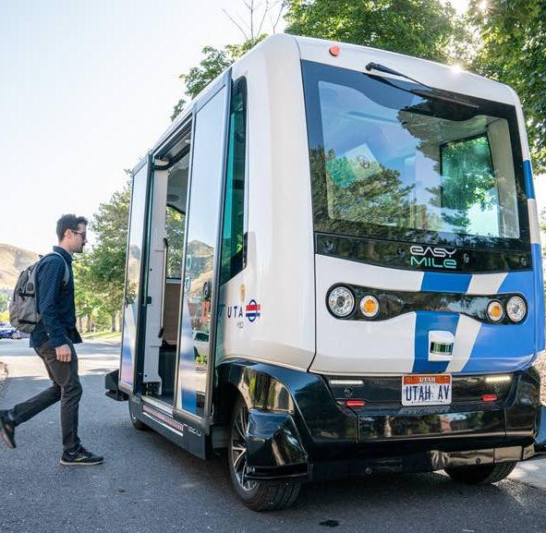
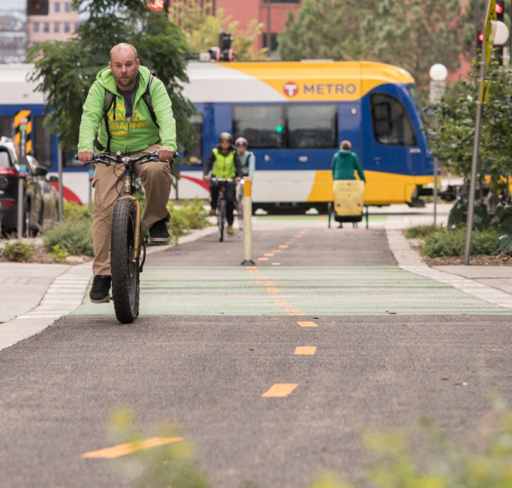
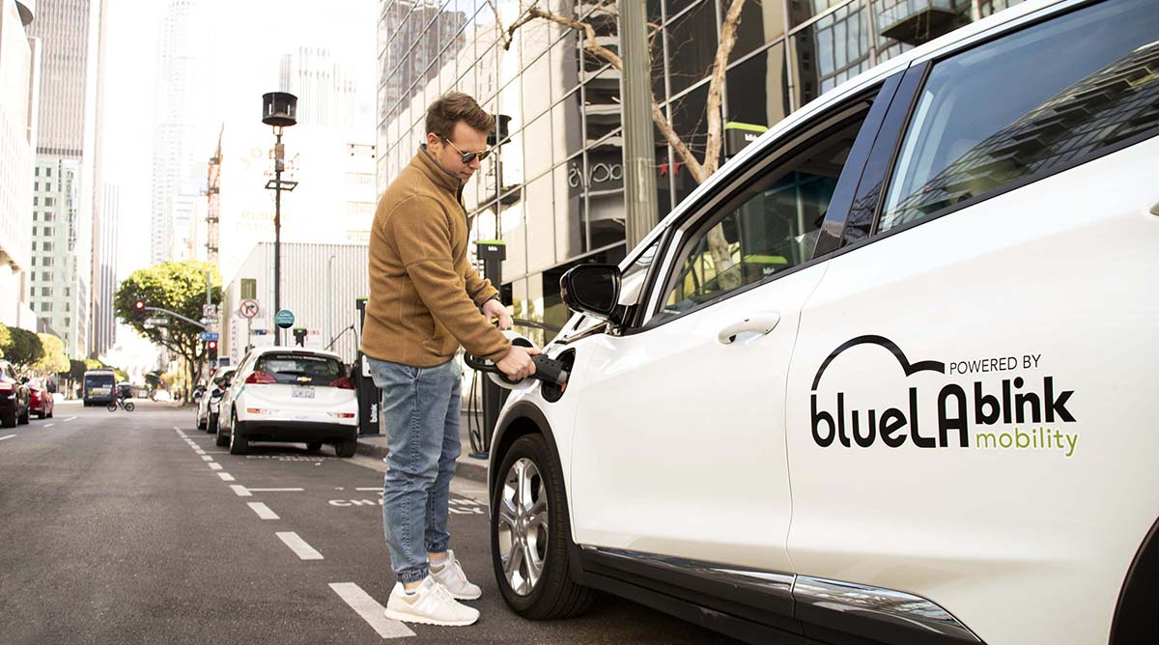
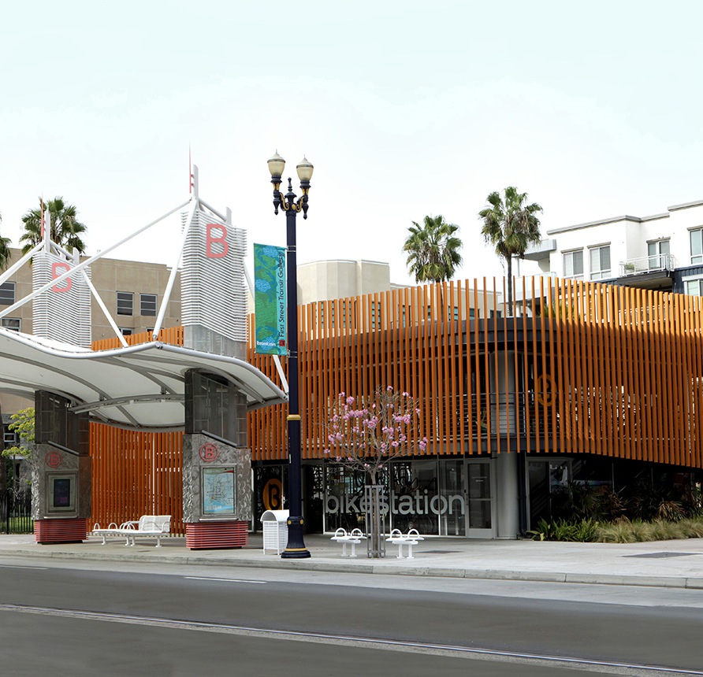
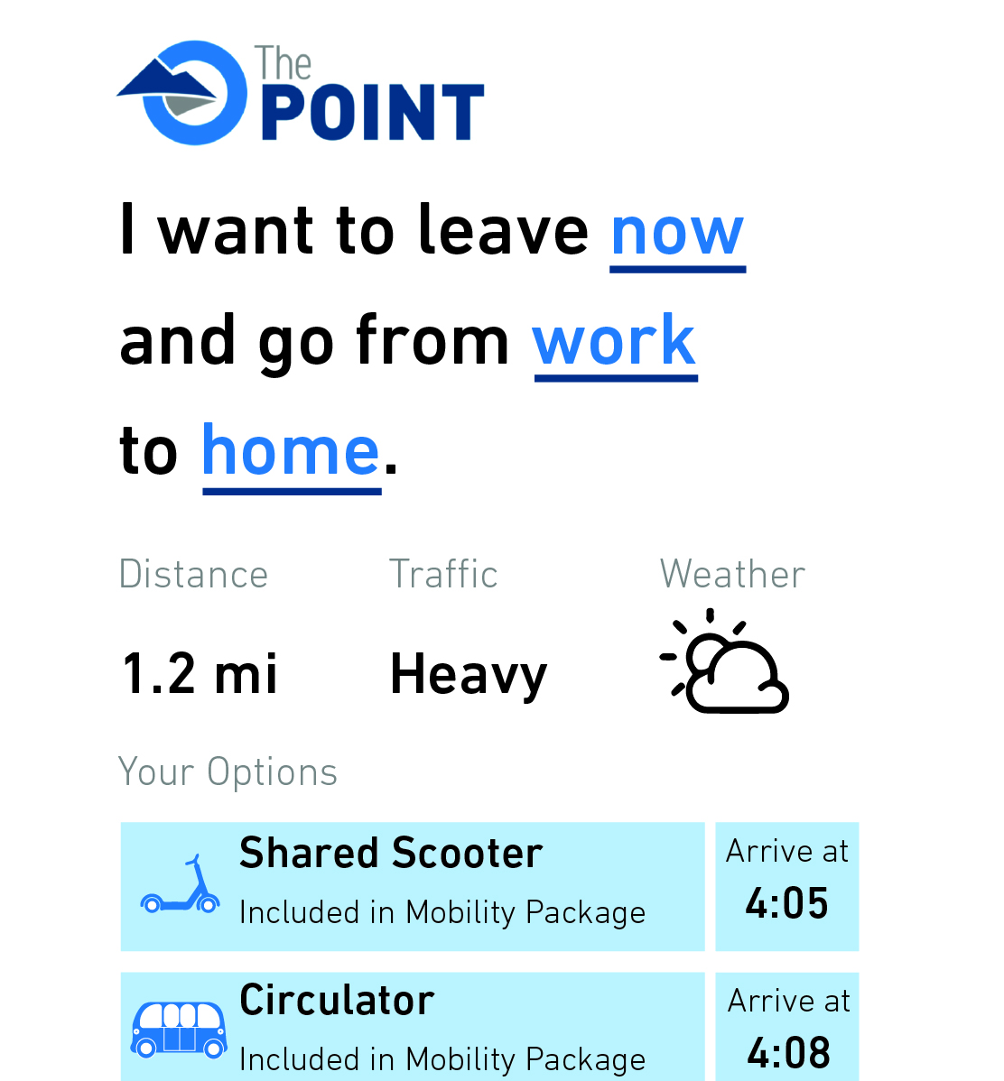
Smart Mobility
Program Elements
Circulator
Active Transportation + Micromobility
Car Share
Mobility Hubs
Mobility as a Service + Mobility Package
An internal transit service
A fleet of shared bikes, e-bikes, and e-scooters
A fleet of shared cars that gives residents and workers access to a car when they need it
Dedicated spaces across the site that bring together the many mobility options at
A platform that compiles The Point’s mobility options into a single application and payment channel
Notes:
-An internal transit service operating in a dedicated right of way that links key destinations across the site and provides first/last mile connections to BRT.
-A fleet of shared bikes, e-bikes, and e-scooters accompanied by design and technology solutions that deliver a safe, comfortable experience for people of all ages and abilities.
-A fleet of shared cars that gives residents and workers access to a car when they need it while encouraging people to use transit, walking, and biking for more trips.
-Dedicated spaces across the site that bring together the many mobility options at The Point—along with information, wayfinding, and amenities—to create a unified, easy to use, and convenient system.
-A platform that compiles The Point’s mobility options into a single application and payment channel, enabling users to plan and pay for trips across different modes in one place. -Residents and workers also receive discounts to incentivize using transit, walking, biking, and shared modes

Slide 14
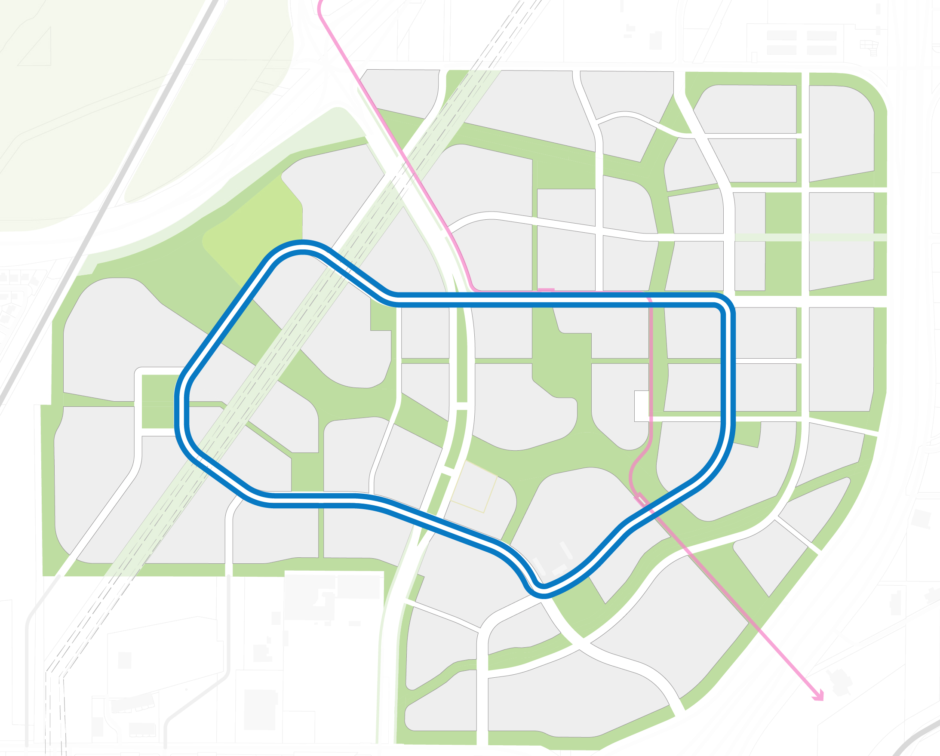
Smart Mobility
Circulator
What is it?
An internal transit service operating in a dedicated right of way that links key destinations across the site and provides first/last mile connections to BRT.
How will it benefit The Point?
Provide universal mobility for all residents, workers, and visitors, regardless of age or ability, without the need for a car.
Foster “park once” behavior and reduce the need for expensive urban parking. This encourages the healthier behavior of walking between destinations and increases pedestrian activity, the lifeblood of urban places.
Help create a healthy, one-car community by reducing the need for short vehicle trips to key destinations such as retail and places of work.
Support BRT ridership by providing a simple, convenient first/last mile connection. More BRT ridership will allow for higher frequency, leading to more convenience for all riders.
Circulator runs every 5-10 minutes in a dedicated lane, linking all of the district cores to both BRT stations.
Notes:
Not autonomous at first
We’re making it forward compatible; Policy and legal constraints on when it can become autonomous (an accident elsewhere can derail)

Slide 15
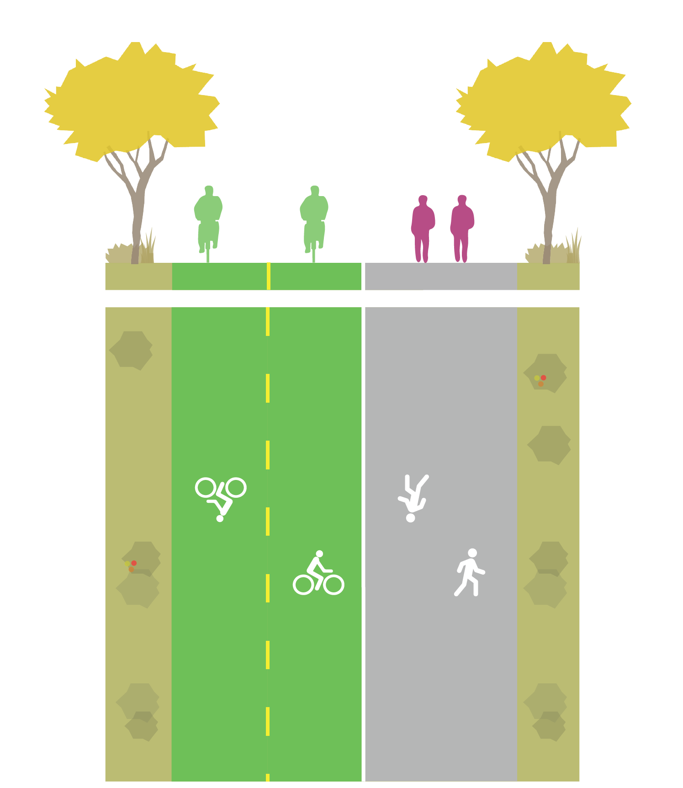
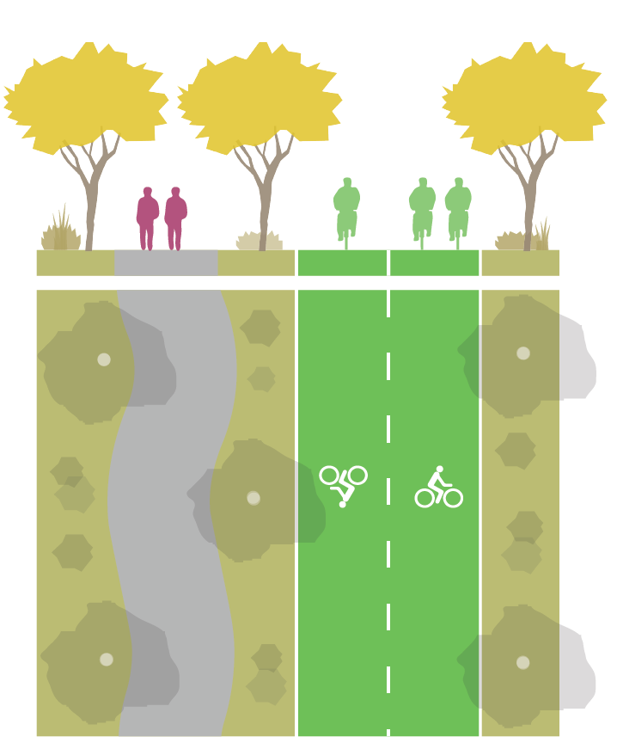
Smart Mobility
Active Transportation + Micromobility
What is it?
A fleet of shared bikes, e-bikes, and e-scooters accompanied by design and technology solutions that deliver a safe, comfortable experience for people of all ages and abilities.
How will it benefit The Point?
Enable first/last mile connections to BRT and the circulator.
Foster “park once” behavior and reduce the need for expensive urban parking.
Help create a healthy, one-car community by reducing the need for short vehicle trips.
Providing separated paths for people walking and people biking/using micromobility creates a safe, orderly environment.
Notes:
Designed world class pathway program with distinct purpose designed lanes (baby in stroller and 20mph cycle compute example)
Proposing 2-3 vendors; city has access to vehicle usage, parking, etc.; balanced at peak times and throughout the day and end of day
E-assist bikes for uphill; dumb scooters vs scooters w/ electric throttle 15 mph

Slide 16
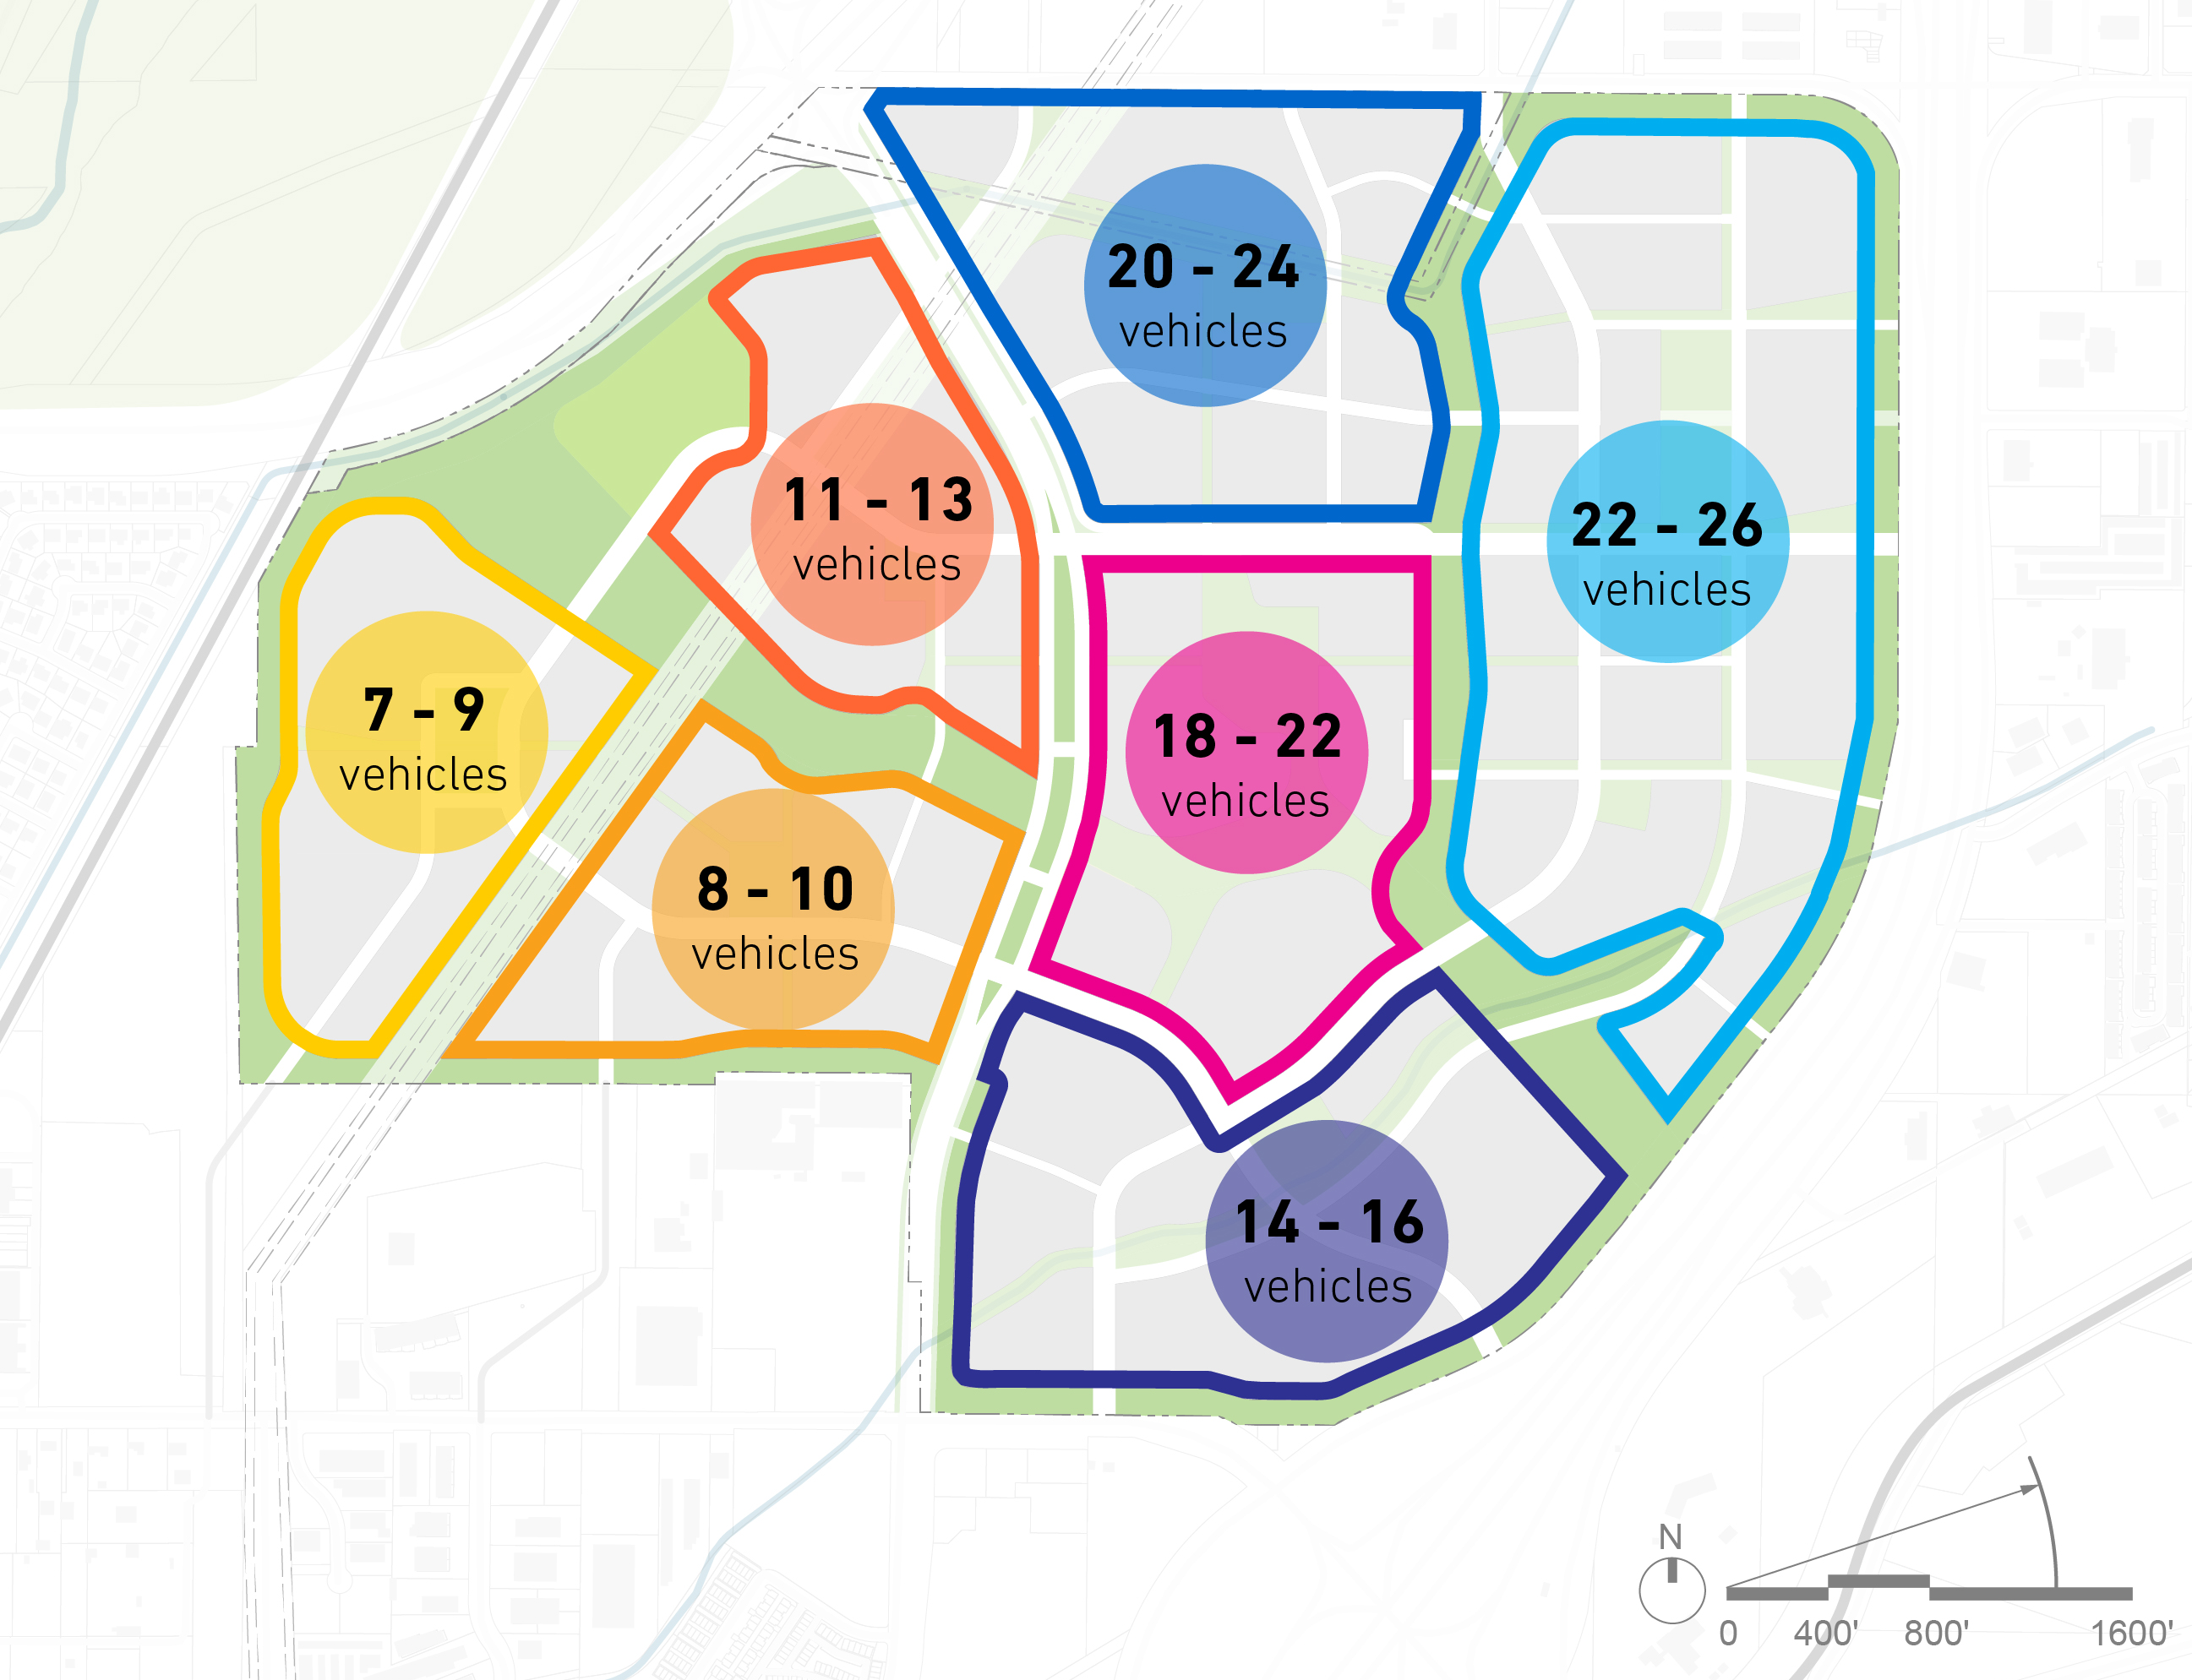
Smart Mobility
Car Share
What is it?
A fleet of shared cars available for short-term rentals. Car share provides users with access to a car when they need it while encouraging people to use transit, walking, and biking for more trips.
How will it benefit The Point?
Reduce the number of vehicles households at The Point own and foster a one-car community. Each car share vehicle provided can eliminate up to 13 person vehicles.
Reduce the amount of expensive urban parking needed at The Point.
Enable residents at The Point to drive less. Car share members drive up to 40% fewer miles than they did before joining.
Save families at The Point money by lowering household transportation costs.
Example target distribution of car share vehicles by district with 100-120 total vehicles.
Notes:
Allocations based on other projects / best practices
Zip car
Car share is to try to serve to hike, ski, or trip to Costco to achieve 1 or 0 car household

Slide 17
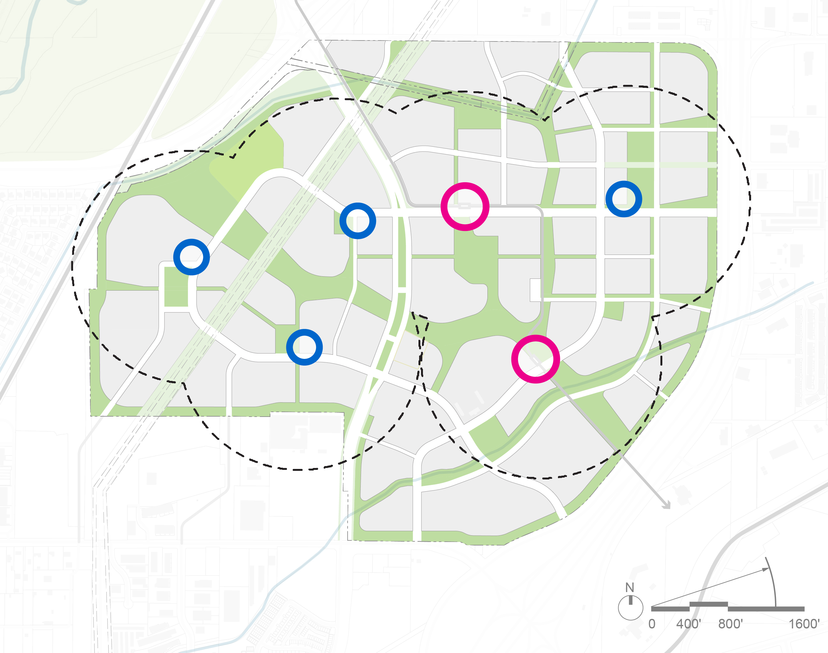
Smart Mobility
Mobility Hubs
What is it?
Mobility hubs bring together the many mobility options at The Point—along with information, wayfinding, and amenities– to enable seamless connectivity.
How will it benefit The Point?
Bring together the many mobility options at The Point into a unified, easy to use, and convenient system.
Improve availability of transportation information and wayfinding to empower smart decision making.
Enable first/last mile connections to BRT and the circulator.
Foster “park once” behavior and reduce the need for expensive urban parking.
90% of the site w/in a 5-minute walk of a regional or district mobility hub (Good scenario)
Regional Mobility Hubs
District Mobility Hubs
Notes:
Info, wayfinding,
Micro hub – one mode location, e.g., painted dedicated space for scooters to help reach circulator stop
District – take place on curb space; combines mobility uses i.e., scooters, circulator stop, etc (may be built by HOA/dev)
Regional – combined with others uses; café, fedex shipping/amazon, connected to a retail store, and more combo, i.e., micro, circulator, BRT, car share (integrated into development , cost shared)

Slide 18
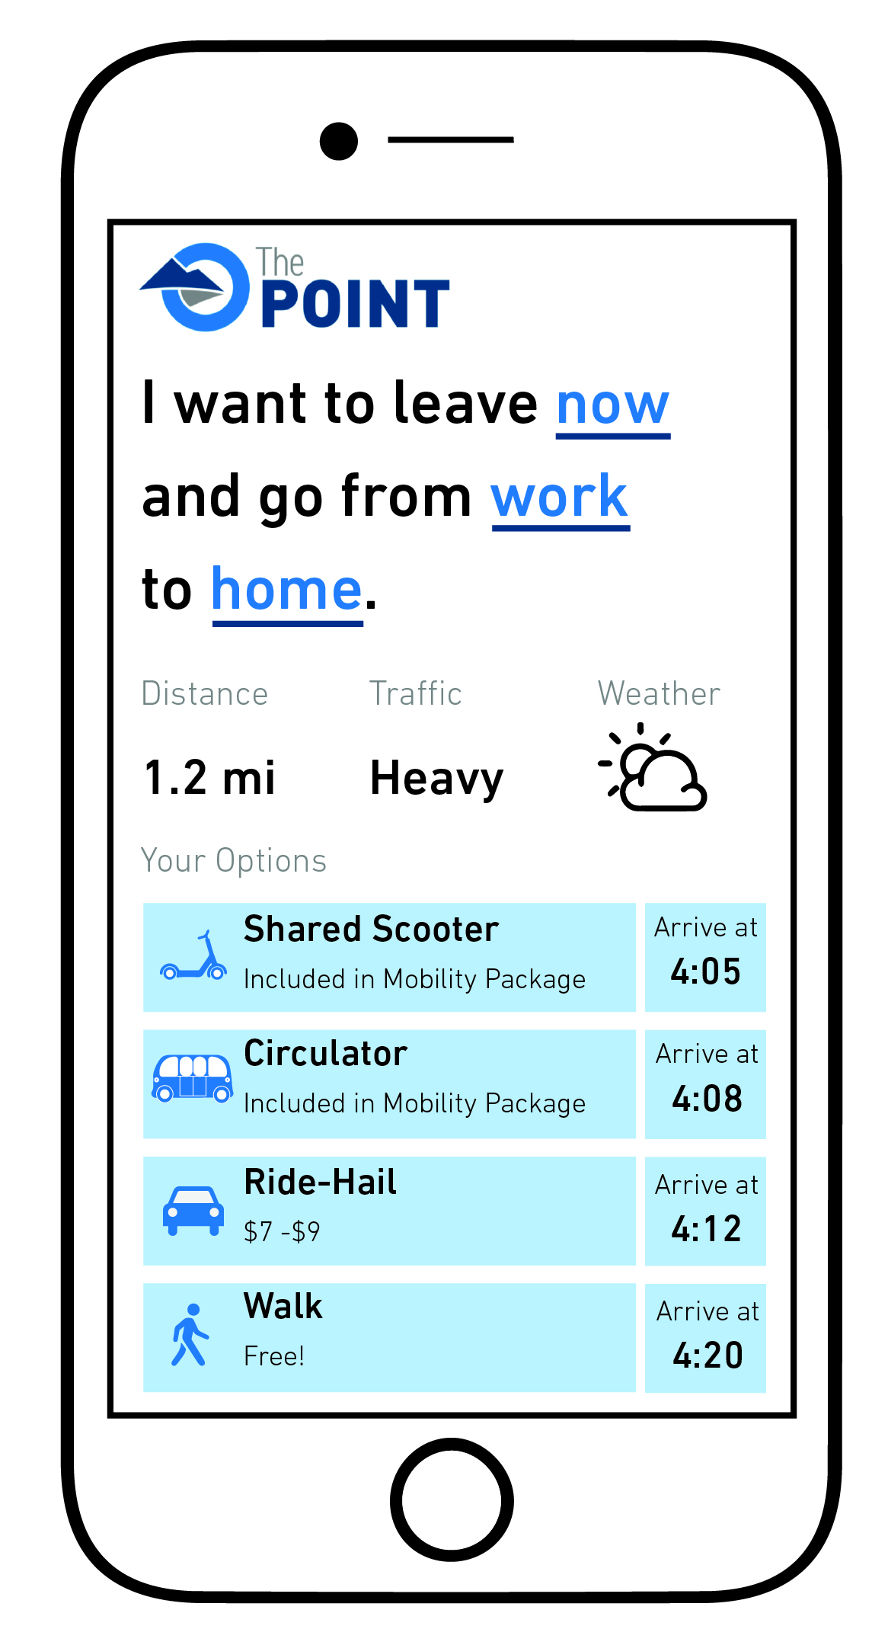
Smart Mobility
Mobility as a Service + Mobility Package
What is it?
A platform that compiles The Point’s mobility options into a single application and payment channel, enabling users to plan and pay for trips across different modes in one place. Residents and workers also receive discounts to incentivize using transit, walking, biking, and shared modes.
How will it benefit The Point?
Bring together the many mobility options at The Point into a unified, easy to use, and convenient system.
Improve availability of transportation information and wayfinding to empower smart decision making.
Incentivize alternatives to driving alone and reduce driving.
Reduce the number of vehicles households at The Point own and foster a one-car community.
Reduce the amount of expensive urban parking needed at The Point.
Save families and employees at The Point money by lowering household transportation costs.
Notes:
MAAS – allows you to pay for any service offered; under one umbrella, understand the cost, time, route, to get to your destination; as opposed to today, you look at uber, UTA, zip car, spin apps separately
This also includes the subsidies for best practice in TDM policy, that encourage people to drive less and take these modes more

Slide 19
Smart Mobility
Scenario Evaluation Process
 | Alt. 1 | Alt. 2 | Alt. 3 | Alt. 4 | Alt. 5 | Alt. 6 | Alt. 7 | Alt. 8 | Alt. 9 | Alt. 10
Circulator
Active Transportation + Micromobility
Car Share
Mobility Hubs
MaaS + Mobility Package
Cost
Impact
Benefit : Cost
$ / Trip Reduced
Synthesize Good/Better/Best scenarios for each program element and evaluated a range of potential scenarios based on key performance metrics (total annualized cost, total monetized societal impact, benefit : cost ratio, and $/trip reduce).
Identified four scenarios for more detailed investigation and analysis:
Two scenarios act as bookends (alt. 1 acts as low-cost scenario, alt. 10 is maximum impact scenario).
Two scenarios offer best balance of cost and impact (alt. 3 and alt. 4).
Good
Best
Better
High
Low
Low
High
Low
High
High
Low
Notes:
Mixed and matched 10 different approaches for these services and $ and benefits, etc
We try to optimize marginal cost and impact (alt 1 vs alt 10, cost / benefits; alt 3 and 4)

Slide 20
Smart Mobility
Scenario Evaluation Process
Scenario 1 – Low Cost
Scenario 2 – Middle, Cost-Conscious
Scenario 3 – Middle,
Lean Impact
Scenario 4 – Maximum Impact
Car Share | Best
Micromobility + AT | Good
Circulator | Better
Mobility Hubs | None
MaaS + Mobility Subsidy | None
Car Share | Best
Micromobility + AT | Good
Circulator | Better
Mobility Hubs | Good
MaaS + Mobility Subsidy | Good
Car Share | Best
Micromobility + AT | Good
Circulator | Better
Mobility Hubs | Good
MaaS + Mobility Subsidy | Better
Car Share | Best
Micromobility + AT | Best
Circulator | Best
Mobility Hubs | Best
MaaS + Mobility Subsidy | Best+
Notes:
Alts 1-4 ; across top you see the chosen scenarios; then the good/better/best selection for each and then a Radar plot is all benefits (walk through)
Scenario 1 is the bare minimum for standard ridership but does not achieve trip reductions needed or environmental/sustainability benefits – (as it does not include MaaS or Mobility Hubs)
The subsequent scenarios help capture the additional ridership needed to alleviate traffic/congestion at the site, through reduced VMT, and that help create a pedestrian friendly environment with the type of activation needed to make it a regional draw and really to catalyze a paradigm shift for the region in terms of smart mobility

Slide 21
Smart Mobility
Scenario Evaluation Process
Good
Better
Best
Middle, Cost-Conscious
Middle, Lean Impact
Maximum Impact
Car Share | Best
Micromobility + AT | Good
Circulator | Better
Mobility Hubs | Good
MaaS + Mobility Subsidy | Good
Car Share | Best
Micromobility + AT | Good
Circulator | Better
Mobility Hubs | Good
MaaS + Mobility Subsidy | Better
Car Share | Best
Micromobility + AT | Best
Circulator | Best
Mobility Hubs | Best
MaaS + Mobility Subsidy | Best+
Recommend Better scenario as starting point with potential for phased/scaled approach.
Delivers significant benefits and impact while managing costs.
Strong ROI for Land Authority, horizontal, and vertical developer.
Sufficient level of initial investment to effectively scale key program elements based on results and project needs.
Notes:
We recommend the Better scenario as the preferred program

Slide 22
Smart Mobility
Recommended Scenario
Circulator
Active Transportation + Micromobility
Car Share
Mobility Hubs
Mobility as a Service + Mobility Package
2.3-mile route connecting key destinations
12 vehicles serve stops every 5 minutes during peak periods and 10 minutes off-peak
Anticipate operating with a driver but preserving pathway to driverless operations as technology improves
Estimate 900 – 1,000 riders per day at full buildout
Fleet of 150 – 200 shared micromobility vehicles (i.e. electric scooters and bikes)
4 shared micromobility vehicles per 1,000 residents/employees
Combination of design and technology solutions to ensure comfort and safety for all users
Parking and charging standards for both personal and shared micromobility
Fleet of 100 – 120 shared, electric vehicles
16 car shares per 1,000 dwelling units
Mix of incentives and cost sharing to achieve 100% EV share
Shared cars located in parking facilities, designated on-street parking spaces, and at mobility hubs
Hubs at both BRT stations and in district cores enable connections between mobility options along with additional amenities
90% of the site is within a 5-minute walk of a larger (regional or district) hub
Microhubs located within public space at select circulator stops offer smaller set of amenities
App for planning, booking, and paying for trips across different transportation options
Discounted transit passes and free memberships for car share and shared micromobility for residents/employees
Monthly mobility credit applied to use of sustainable modes
Estimate >25% of residents/employees actively use program
Notes:
If you’re a resident or employee at the point your offered a suite of mobility options to achieve goals….
----
Circulator in 2 directions
Employees and residents and automatically enrolled, with free membership but a capped amount of free rides however there is a mobility credit – incentive to try out the system (someone who owns a car may be reluctant)

Slide 23
Smart Mobility
Recommended Scenario—Capital Costs
$54.6 M
$20 M
Additional capital costs over baseline
Total Economic Benefit
(parking and land value savings)
Notes:
Baseline is framework plan (trail system, roadway network);
The increment column includes: circulator (vehicles, stations, row); active transportation (trail, intersection, and crossing enhancements); car share (ev vehicle subsidies and charging stations); mobility hubs (structure costs and all amenities); MaaS (app development)
Cost benefit is more than 2 to 1; it allows us to ramp up in the future if we want to have more robust options (roughly the cost of a nice light rail station)
20 year time horizon for economic benefit

Slide 24
Smart Mobility
Recommended Scenario—Annual Operations & Maintenance Costs
$26.8 M
$7.1 M
Additional O&M costs over baseline
Annual Societal Benefit
(congestion, health, and
household cost savings)
Notes:
The increment column includes: circulator (net operating costs [operating cost - ad revenue]); active transportation (additional maintenance for wider trails); car share (vehicle charging costs); mobility hubs (maintenance and subscriptions); MaaS (app maintenance and mobility subsidies)
Societal benefit – congestion data GHG analysis using fed standards; opportunity savings over average cost of owning a vehicle ($9k per /yr); used metrics from walking and health care costs

Slide 25
Smart Mobility
Recommended Scenario—Annual Costs and Benefits by Responsible Party
Association Fee (O&M)
Vertical Developer Benefits (parking savings)
Vertical Developer Costs
(20-year amortized capital)
Horizontal Developer Benefits (land value savings)
Horizontal Developer Costs (20-year amortized capital)
Land Authority Benefits
(societal benefits)
Land Authority Costs
(20-year amortized capital)
Notes:
Breakdown on costs and savings
---
HOA would support operating costs for circulator, car share, micro mob, and Maas
LA cost are for capital cost contributions for the circulator, mobility hubs at brt stations, river to range trail, subsidies for ev vehicles for car share, and development of MaaS app
20 year time horizon savings

Slide 26
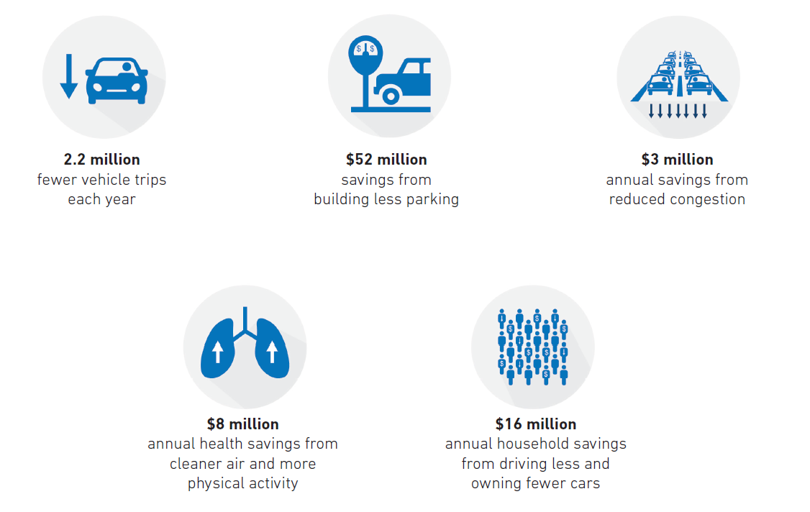
Smart Mobility
How will smart mobility benefit The Point and the region?
Results from recommended program
Notes:
Equivalencies

Slide 27
Sustainability & Smart Technology Workstreams

Slide 28
Strategies
Water
Baseline | Good | Better | Better+ | Best | Best +
Meets existing Code requirements | Water Efficient Fixtures (EPA WaterSense) Lawn to Water Efficient Landscape (Minimal) | Water Efficient Fixtures (EPA WaterSense) Lawn to Water Efficient Landscape (Moderate) Secondary Water for Irrigation (Partial) Rooftop Rainwater with Barrels | Water Efficient Fixtures (EPA WaterSense) Lawn to Water Efficient Landscape (Moderate) Secondary Water for Irrigation (100%) Rooftop Rainwater with Barrels | Water Efficient Fixtures (EPA WaterSense +) Lawn to Water Efficient Landscape (Aggressive) Secondary Water for Irrigation (100%) Rooftop Rainwater with Barrels | Water Efficient Fixtures (EPA WaterSense +) Lawn to Water Efficient Landscape (Aggressive) Secondary Water for Irrigation (100%) Secondary water for toilet flushing for NonRes Rooftop Rainwater with Barrels
Notes:
Circles are innovative program
Secondary Water for toilet flushing
Currently WaterPro is using blended Utah lake water with treated water which won’t work for toilet flushing for NonRes; also question over WaterPro water rights to use it for toilet flushing (JVWC treats the water but it’s supplied by WaterPro)

Slide 29

Strategies
Buildings: Energy
Building Types
Baseline | Good | Better | Better+ | Best
Meets existing Code requirements Commercial: IECC 2018 Residential: IECC 2015 Public realm LED lighting with basic controls | Meets next Code cycle requirements Improved building envelope Higher efficiency HVAC and service water heating More efficient lighting systems (fixtures & controls) LEED Gold 30% solar PV on rooftop areas | Full electrification building systems (heating, service hot water) Same envelope upgrades as Good Smart controls for Lighting in Public Realm LEED Gold/Platinum Up to 50% solar PV on rooftop areas | Full electrification building systems (heating, service hot water) High performance envelope (not passive) Smart controls for Lighting in Public Realm LEED Gold/Platinum Up to 50% solar PV on rooftop areas | Best in class performance (including triple glazing More efficient HVAC and lighting Smart controls for Lighting in public realm LEED Platinum +++ 50% solar PV on rooftop areas (community solar)
Apartment (Mid-Rise)
Hotel (Small)
Office (Large)
Office (Medium)
Retail (Standalone)
Retail (Ground Floor Retail)
School (Secondary)
Single-Family
Industrial
District Heating & Cooling
District Heating & Cooling
District Heating & Cooling
Notes:
Goal optimized has no Geo Thermal
Cost optimized has district Geo Thermal (ESCO)
Innovation optimized has district Geo Thermal (ESCO)

Slide 30

Strategies
Waste
Baseline | Good | Better | Best
Standard existing City of Draper Waste Management Practices | Waste Management Education Program Item Exchange/Donation Program Enhanced Recycling Systems (3-bin Waste Collection Systems) | Food Waste Recycle Program for Commercial Waste Management Education Program Item Exchange/Donation Program Enhanced Recycling Systems (3-bin Waste Collection Systems) | Pay-As-You-Throw Program Food Waste Recycle Program for Commercial and Residential Waste Management Education Program Item Exchange/Donation Program Enhanced Recycling Systems (3-bin Waste Collection Systems)
+
Smart Technologies for Refuse Collection
Notes:
Pay-as-you-throw (PAYT):
Customers/tenants are charged for waste disposal based on the amount generated rather than a flat-fee. There are two types of PAYT programs, by volume or by weight.
According to EPA, most communities charge residents by volume, using either bags or cans (or tags or stickers indicating specific can or bag sizes) as their program's unit of measure.
For example, the rate structure requires all trash to be placed in city-approved bags (i.e. $1 or $2 per bag depending on size) available for purchase at area retailers and other designated locations (i.e. city) .
Materials Exchange program
Develop or facilitate an online network to foster business-to-business connections to match unwanted material byproducts or commodities to opportunities for reuse or recycling as feedstock. e.g., computers, containers, furniture, office supplies, textiles, and surplus food.
Waste education – waste standards in leases, apt bldg. owner standards, community education,
3 Bin – waste, recycle, food/organics

Slide 31
Smart District
Smart Systems
Smart ICT Infrastructure
Conduits and Inner Duct Systems
Fiber Optic Cable Infrastructure
Wi-Fi Infrastructure
Passive Optical Network Infrastructure
Fiber meet-Me Rooms
Smart Community
Wastewater Monitoring System for Public Health
Smart Kiosks
Smart Refuse
Smart Community App
The Point OpenData
Community Smart Wall
Smart Environment
Air Quality Sensors
Sound Level Monitoring
Micro-Climate Sensors & Controls
Water Quality Monitoring
Smart Lighting
Tree Health Monitoring
Smart Mobility
Smart & Connected Intersections
Smart Parking
Circulator
Active Transportation + Micromobility
Car Share
Mobility Hubs
Mobility as a Service
EV Adoption
Smart Utilities
Centralized Energy Monitoring
Community Microgrid
Community Water Monitoring
Dynamic HPC (High Performance Compute) Optimization
Smart Buildings
Connected, Predictive, or Adaptive Building
Notes:
Community micro grid – which is a model that allows power in particular solar to be allocated across building in the community for more cost effective pricing and efficient service
EV – 3rd party to build and operate; 10k w/ 2/3 in offices
HPC – micro data center that allows for cost effective dynamic demand power mgmt. at the site, including load banking as a revenue stream to avoid demand charges and optimize return on solar

Slide 32
Smart District
Smart Buildings
Recommended
Optional
Notes:
This is a granular slide, but at a high level, we want to bring best in class sustainability and energy efficiency measures as well as building automation solutions into buildings at the point ; including smart metering, lighting control systems, building management systems, AND creating showcase civic and institutional buildings that use digital twin and other advanced technologies
Digital twin – virtual replica of the building in 5D (time/cost) to model building performance and operations including predictive analytics to improve cost and user experience in facilities

Slide 33
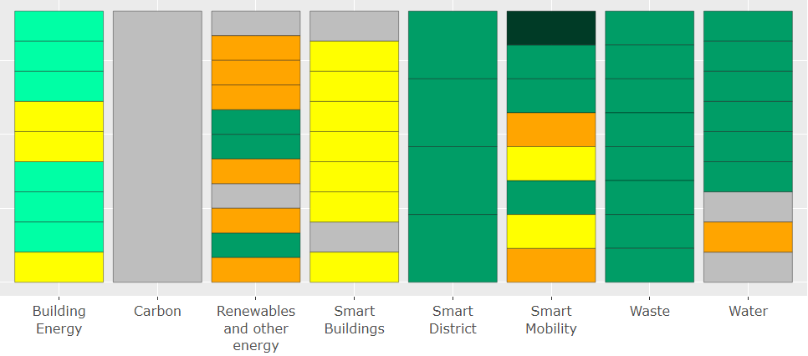
Gameboard Options
Strategies from the Cost Optimized Scenario
Baseline
Apartments
Apartments
Apartments
Smart ICT
EV Adoption
Pay-As-You-Throw
Residential
Good
hotel
hotel
hotel
Zero Organic Waste Goal
Office
Office (large)
Smart Parking
Better
Office (large)
Office (large)
Smart Intersections
Food Waste Recycle (NR)
Retail
Better +
Office (med.)
Smart Environment
Office (med.)
Retail
Office (med.)
Food Waste Recycle (Res.)
Innovation
Circulator
Best
Retail
Embodied carbon
Retail (GF)
Retail
Institutional
Active Transportation
WM Education
Retail (GF)
Institutional
Retail (GF)
Smart Utilities
Other
Single Family
Car Share
Item Exchange
Institutional
Institutional
Landscape
Industrial
Mobility Hubs
3-bin System
Ext. Fixture Efficiency
Single Family
District Energy
Single Family
Smart Community
Industrial
Public Realm
Industrial
MaaS
Bulk Recycling
Water Reuse
Notes:
This slide is an example of the game boarding process we went through to test various combinations of strategies and based on set goals, constraints and trade offs arrived at an optimized program

Slide 34
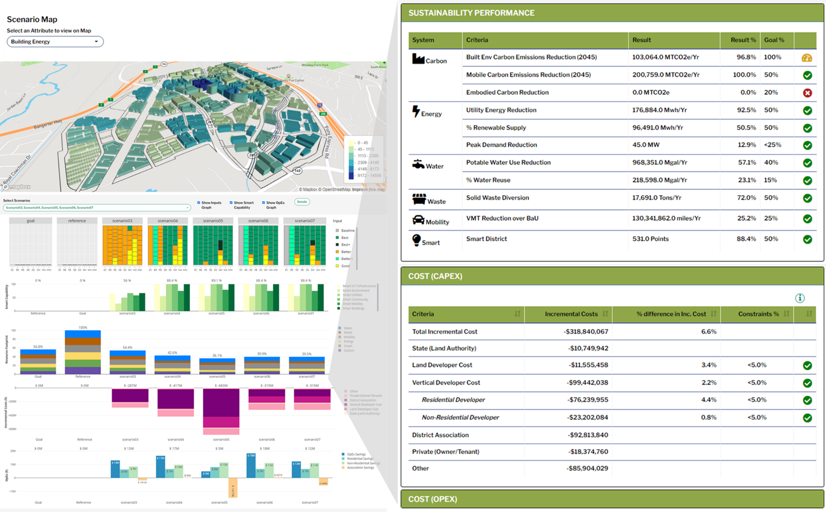
Sustainability Model
Notes:
And one of the benefits of the work is that we now have a dynamic model down to the parcel level we can adjust at the click of a button as needed as we collaborate with our development partner and other P3 partners on finalizing the right program.

Slide 35
Program Scenarios
Notes:
I mentioned the three scenarios of Goal optimized, Cost Optimized and Innovative which we’ll dive into more here
Goal – This scenario attempts to maximize the number of goals achieved while keeping overall cost premiums <= 2% and simpler governance for how the strategies are managed
Cost – This scenario meets or exceeds most goals while keeping within a +1.5% cost premium for commercial buildings but requires some investment comes out of the land value which is in essence a subsidy to the developer
Innovative – This scenario meets or exceeds most goals while keeping within reasonable cost premiums to the developers, but requires an innovative financing and governance model.

Slide 36
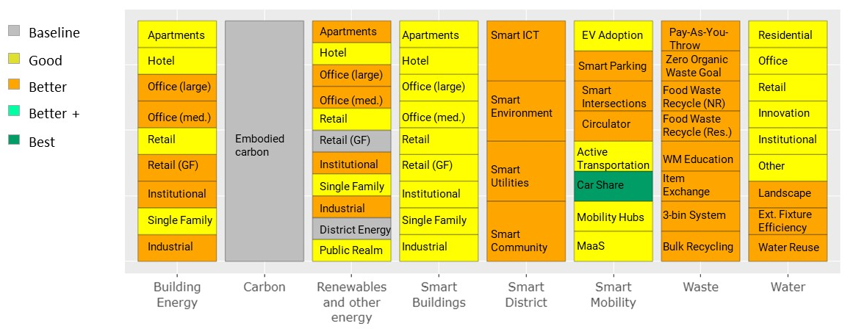
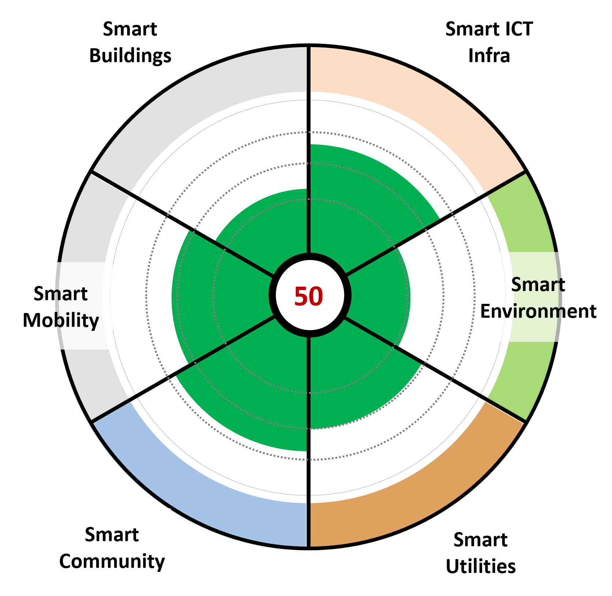
Goal Optimized
Performance
Strategy Packages
Sustainability Performance
Smart Capability Score
Timeframe
2050
 | Result | Result Units | Result % | Goal %
Built Env Carbon Emissions Reduction | 96,597 | MTCO2e/Yr | 90% | 100%
Mobile Carbon Emissions Reduction | 99,945 | MTCO2e/Yr | 50% | 50%
Embodied Carbon Reduction | 0 | MTCO2e | 0% | 20%
Utility Energy Reduction | 117,578 | Mwh/Yr | 61% | 50%
% Renewable Supply | 81,136 | Mwh/Yr | 52% | 50%
Peak Demand | 44.4 | MW | 10% | < 25%
Potable Water Use Reduction | 655,081 | Mgal/Yr | 39% | 40%
% Water Reuse | 162,134 | Mgal/Yr | 14% | 15%
Solid Waste Diversion | 13,532 | Tons/Yr | 55% | 50%
VMT Reduction over BaU | 123,798,883 | Miles/Yr | 24% | 25%
Smart District | 299 | Points (per 600) | 50% | 50%
Notes:
Goal – This scenario attempts to maximize the number of goals achieved while keeping overall cost premiums <= 2% and simpler governance model
In the top right we have the good/better/best game boarding outcome across the various systems
On the middle of the page, you can see we achieve most goals including xxxxx; but are a bit short on carbon emissions at 90% and we aren’t able to achieve the embodied carbon target
On the right we show a modest score for the smart technologies to be implemented
Other trade offs are no district energy, no community solar and it includes UA for smart infra (at a modest cost relatively speaking) and assumes savings from parking savings is invested by the vertical developers which is a point that will have to be work out with the development partner

Slide 37
1. Goal Optimized
CapEx
Cost Performance - CapEx
Incremental Cost
Incremental Cost / SF
% Cost Incremental
Constraints %
Total Incremental Cost | ($129.0M) | ($7.95) | +2.7%
State (Land Authority) | ($10.7M) | ($0.66)
Land Developer Cost | ($6.1M) | ($0.38) | +1.8% | < 5.0%
Vertical Developer Cost | ($83.7M) | ($5.16) | +1.9% | < 5.0%
Residential Developer | ($30.3M) | ($3.90) | +1.8% | < 5.0%
Non-Residential Developer | ($53.4M) | ($6.31) | +2.0% | < 5.0%
Utility Association | ($1.2M) | ($0.08)
Private (Owner/Tenant) | ($14.4M) | ($0.88)
Other (ESCO etc.) | ($12.9M) | ($0.80)
Note: negative values represent costs, positive as savings
Notes:
Here we show how the $130M of capex needed is allocated across stakeholders and that we’re able to keep it under 2% for development partners
There’s a significant investment by the Vertical Developer in solar energy, which can help be financed through a significant savings from not having to build the typical amount of structured parking a standard development would need; this is an important assumption and one we’ll need to discuss with our future development partner, but from our modelling we know there’s some room for essentially reallocating the savings from those costs. There’s also an annual opex savings that will pay back their investment relatively quickly

Slide 38
Vertical Developer Capex | Net | NRES | RES
Carbon | $0M | $0M | $0M
Water | -2M | -2M | -1M
Energy | -2M | $0M | -3M
District Energy | $0M | $0M | $0M
Solar | -140M | -82M | -58M
Smart Buildings | -24M | -12M | -12M
Smart Infrastructure/District/Mobility (AECOM) | $0M | $0M | $0M
Smart Mobility (SS) | $85M | $42M | $42M
Waste | -0M | -0M | -0M
 | -84M | -53M | -30M
1. Goal Optimized
CapEx Detailed
System | CapEX
Water | -$4M
Building Efficiency | -$3M
District Energy | -$0M
Renewables | -$140M
Embodied Carbon | $0M
Waste Management | $0M
Smart Mobility | +65M
Smart Infrastructure | -$23M
Smart Environment | $0M
Smart Utilities | $0M
Smart Community | -$1M
Smart Buildings | -$24M
Net Systems CapEx | -$130M
Horizontal Developer Capex | Net
Carbon | $0M
Water | -2M
Energy
District Energy
Solar
Smart Buildings
Smart Infrastructure/District/Mobility (AECOM) | -10M
Smart Mobility (SS) | $6M
Waste
 | -6M
ThePoint Utility Association Capex | Net
Carbon
Water | $0M
Energy | $0M
District Energy
Solar | $0M
Smart Buildings | $0M
Smart Infrastructure/District/Mobility (AECOM) | -1M
Smart Mobility (SS) | $0M
Waste
 | -1M
ESCO Etc. Capex | Net | NRES | RES
Carbon
Water | $0M
Energy | $0M
District Energy | $0M | $0M | $0M
Solar | $0M
Smart Buildings | $0M
Smart Infrastructure/District/Mobility (AECOM) | -14M
Smart Mobility (SS)
Waste | $0M
 | -14M
State Capex | -11M
Private | -14M
Note: negative values represent costs, positive as savings
Notes:
On this slide a more detailed breakdown of that

Slide 39
1. Conservative: Goal Optimized
OpEx
Cost Performance - OpEx
Annual Savings ($/yr)
Savings/Month
Savings Per
Capita or SF
Total OpEx Change | $8,263,591 | $688,633
Residential Utility & Other OpEx | $4,811,405 | $400,950 | $697 | per HH
Non Residential Utility & Other OpEx | $5,990,248 | $499,187 | $0.71 | per SF
Utility Association OpEx | ($2,538,062) | ($211,505) | ($56) | per Occupant
Utility Association
Incremental Fees & Dues | per year | per month
Residential (Per Unit) | ($126) | ($10.50) | (per HH) | < Savings
Non-Residential (Per SF) | ($0.23) | ($0.02) | (per SF) | < Savings
Net Impact Per Capita / HH / SF | per year | per month
Residential | $571 | $48 | (per HH) | Net + Savings
Non-Residential | $0.48 | $0.04 | (per SF) | Net + Savings
Utility Association | $5 | $0 | (per Occupant) | Net + Savings
Dues based on Amortized CapEx and annual expenses for Utility Association
Note: negative values represent costs, positive as savings
Notes:
Here we see the Opex breakdown and the sources of the $8M annual opex savings;
And ultimately, how this translates to cost savings for people living on site and a 3-5 year pay back for the vertical developer, but with the key assumption, which we’ll need to further validate with our development partner, about the ability to recoup costs through rent premiums and what that ratio looks like; but the math shows that a resident at the Point would pay $126 per year more in rent and HOA fees in order to save $571 in utility costs
UA for smart stuff

Slide 40
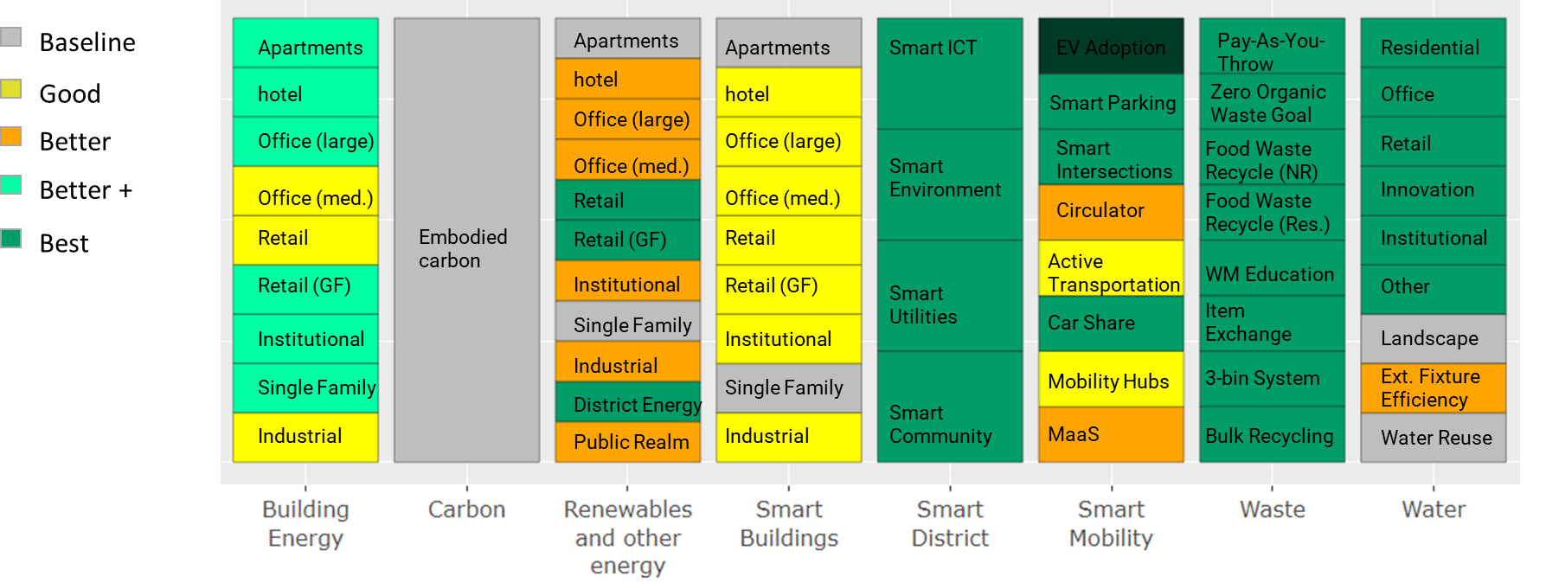
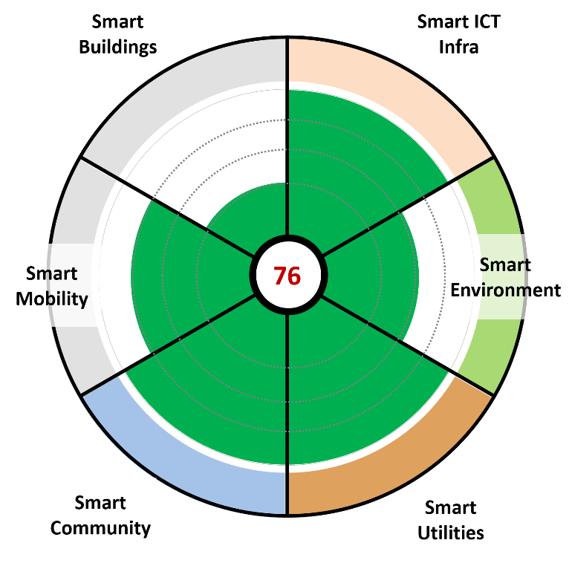
2. Cost Optimized
Performance
Strategy Packages
Sustainability Performance
Smart Capability Score
Timeframe
2050
 | Result | Result Units | Result % | Goal %
Built Env Carbon Emissions Reduction | 96,178 | MTCO2e/Yr | 90% | 100%
Mobile Carbon Emissions Reduction | 183,457 | MTCO2e/Yr | 91% | 50%
Embodied Carbon Reduction | 0 | MTCO2e | 0% | 20%
Utility Energy Reduction | 105,719 | Mwh/Yr | 55% | 50%
% Renewable Supply | 46,101 | Mwh/Yr | 35% | 50%
Peak Demand | 45.6 | MW | 13% | < 25%
Potable Water Use Reduction | 916,953 | Mgal/Yr | 54% | 40%
% Water Reuse | 419,195 | Mgal/Yr | 35% | 15%
Solid Waste Diversion | 8,787 | Tons/Yr | 65% | 50%
VMT Reduction over BaU | 130,341,862 | Miles/Yr | 25% | 25%
Smart District | 456 | Points (per 600) | 76% | 50%
Notes:
This scenario meets or exceeds most goals while keeping within a +1.5% cost premium for Non-residential buildings; it takes $50M out of the land value, but includes community solar (but lower overall solar due to less for residential units), geothermal district energy, and doesn’t have the questions around use of a utility association that the Innovative scenario does
---
$50M of strategies come from RLV to meet the targets (collaborate w/ developers to do more)
-recoverable to vertical dev in 3-5 years from operating expenses (b/c they of long term hold) [savings due to 40% more efficient buildings + solar]
Lower solar usage -- Residential tenants have their own bill for energy and water; vert dev won’t recover it therefore 0 incremental cost (no solar and only partial benefit from district energy)

Slide 41
2. Cost Optimized
CapEx
Cost Performance - CapEx
Incremental Cost
Incremental Cost / SF
% Cost Incremental
Constraints %
Total Incremental Cost | (214.0M) | ($13.19) | +4.5%
State (Land Authority) | (61.7M) | ($3.81)
Land Developer Cost | (11.7M) | ($0.72) | +3.4% | <5.0%
Vertical Developer Cost | (36.3M) | ($2.24) | +0.8% | <5.0%
Residential Developer | $0.3M | $0.04 | -0.0% | <5.0%
Non-Residential Developer | (36.6M) | ($4.33) | +1.3% | <5.0%
Utility Association | - | $0.00
Private (Owner/Tenant) | (18.4M) | ($1.13) | 0%
Other (ESCO etc.) | (85.9M) | ($5.30)
Costs for Developers recoverable through savings
Note: negative values represent costs, positive as savings
Notes:
Here we show the $214M required capex allocation (LA land value reduction)
And how the costs to the developers in particular the vertical developer is minimized which helps make the solutions more viable
Includes an Energy Service Company investing in the Geothermal and community solar solutions

Slide 42
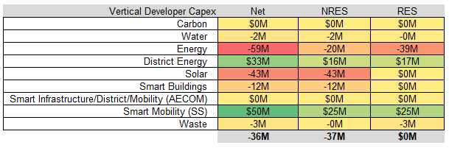
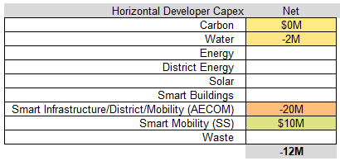
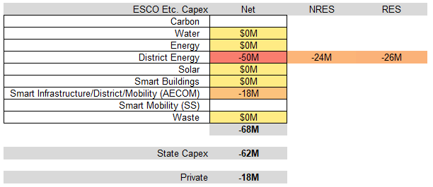
2. Cost Optimized
CapEx Detailed
System | CapEX
Water | -4M
Building Efficiency | -26M
District Energy | -50M
Renewables | -43M
Embodied Carbon | $0M
Waste Management | -3M
Smart Mobility | $31M
Smart Infrastructure | -37M
Smart Environment | -2M
Smart Utilities | -21M
Smart Community | -3M
Smart Buildings | -12M
Net Systems CapEx | -171M
ThePoint Utility Association Capex | Net
Carbon
Water | $0M
Energy | $0M
District Energy
Solar | $0M
Smart Buildings | $0M
Smart Infrastructure/District/Mobility (AECOM) | $0M
Smart Mobility (SS) | $0M
Waste
 | $0M
Note: negative values represent costs, positive as savings
Paid for by Land Residual Value
Notes:
Again, the detailed view

Slide 43
2. Cost Optimized
OpEx
Cost Performance - OpEx
Annual Savings ($/yr)
Savings/Month
Savings Per
Capita or SF
Total OpEx Change | $2,436,642 | $203,053
Residential Utility & Other OpEx | $2,086,104 | $173,842 | $302 | per HH
Non Residential Utility & Other OpEx | $5,979,866 | $498,322 | $0.71 | per SF
Utility Association OpEx | ($5,629,328) | ($469,111) | ($124) | per Occupant
Utility Association
Incremental Fees & Dues | per year | per month
Residential (Per Unit) | ($271.00) | ($22.58) | (per HH) | < Savings
Non-Residential (Per SF) | ($0.49) | ($0.04) | (per SF) | < Savings
Net Impact Per Capita / HH / SF | per year | per month
Residential | $31 | $3 | (per HH) | Net + Savings
Non-Residential | $0.22 | $0.02 | (per SF) | Net + Savings
Utility Association | $8 | $1 | (per Occupant) | Net + Savings
Dues based on Amortized CapEx and annual expenses for Utility Association
Note: negative values represent costs, positive as savings
Net Savings !
Notes:
And the breakdown of the Opex savings of $2.5M including net savings to the residents, agqain in perpetuity

Slide 44
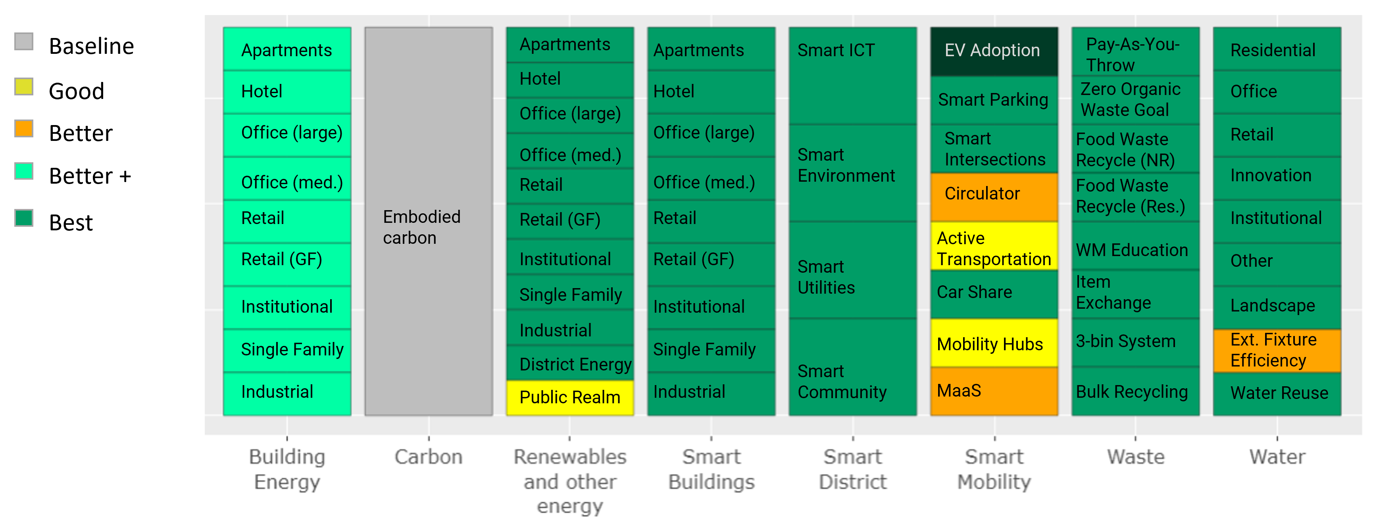
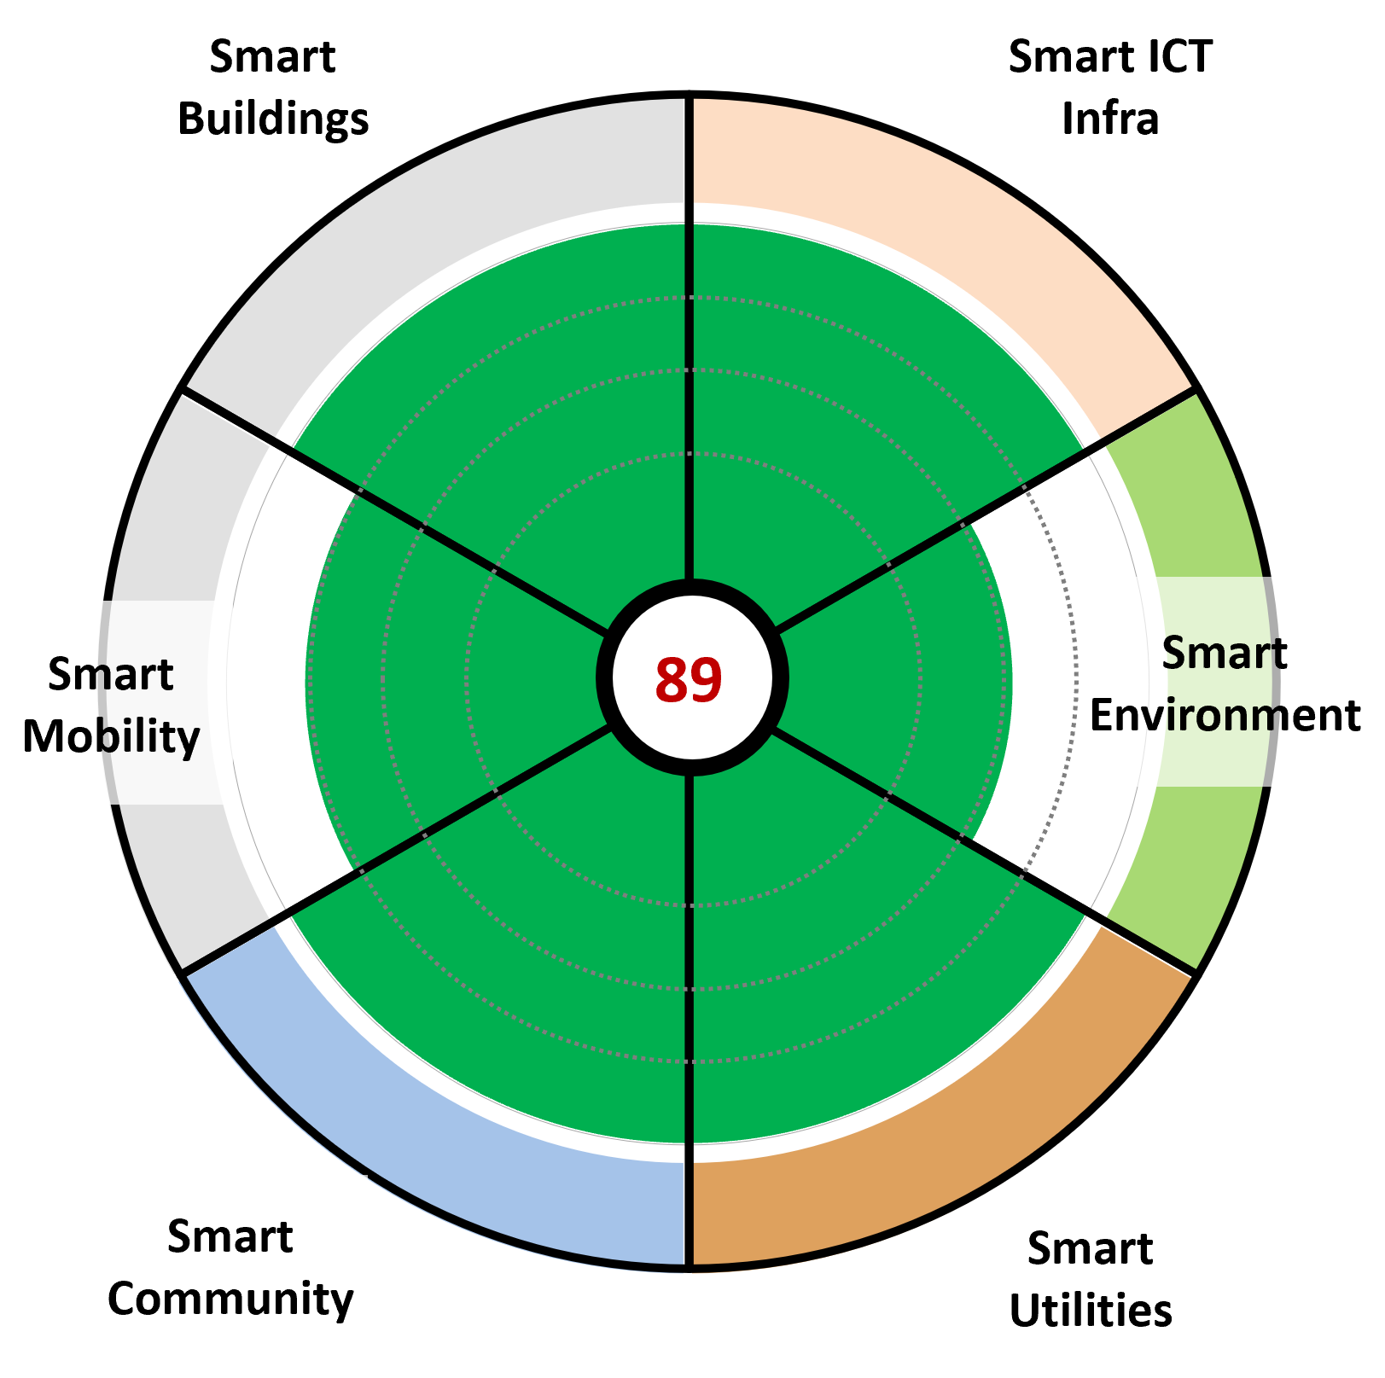
3. Innovative
Performance
Strategy Packages
Sustainability Performance
Smart Capability Score
Timeframe
2050
 | Result | Result Units | Result % | Goal %
Built Env Carbon Emissions Reduction | 105,649 | MTCO2e/Yr | 99% | 100%
Mobile Carbon Emissions Reduction | 183,457 | MTCO2e/Yr | 91% | 50%
Embodied Carbon Reduction | 0 | MTCO2e | 0% | 20%
Utility Energy Reduction | 191,311 | Mwh/Yr | 100% | 50%
% Renewable Supply | 110,919 | Mwh/Yr | 100% | 50%
Peak Demand | 45.4 | MW | 13% | < 25%
Potable Water Use Reduction | 968,351 | Mgal/Yr | 57% | 40%
% Water Reuse | 218,598 | Mgal/Yr | 23% | 15%
Solid Waste Diversion | 17,691 | Tons/Yr | 72% | 50%
VMT Reduction over BaU | 130,341,862 | Miles/Yr | 25% | 25%
Smart District | 531 | Points (per 600) | 88% | 50%
Notes:
Innovative – This scenario meets or exceeds most goals, including zero carbon, has a high smart capability score and keeps within reasonable cost premiums, but requires an innovative financing and governance model.
It also does not require the state to reduce the RLV
ThePoint’s Utility Association is an entity created primarily to :
provide a centralized utility and sustainability services such as community solar, smart mobility and public realm connectivity, smart services such as the mobility and community app
provide governance, sustainability KPI tracking and maintenance of smart infrastructure including smart mobility in public areas
as a non-profit entity, raise capital and funds for investment at ThePoint (such as for community solar) and recover the investment through association dues and fees.

Slide 45
3. Innovative
CapEx
Cost Performance - CapEx
Incremental Cost
Incremental Cost / SF
% Cost Incremental
Constraints %
Total Incremental Cost | ($337.1M) | ($20.78) | +7.0%
State (Land Authority) | ($10.7M) | ($0.66)
Land Developer Cost | ($11.6M) | ($0.71) | +3.4% | < 5.0%
Vertical Developer Cost | ($40.6M) | ($2.51) | +0.9% | < 5.0%
Residential Developer | ($17.4M) | ($2.25) | +1.0% | < 5.0%
Non-Residential Developer | ($23.2M) | ($2.74) | +0.8% | < 5.0%
Utility Association | ($169.9M) | ($10.47)
Private (Owner/Tenant) | ($18.4M) | ($1.13)
Other (ESCO etc.) | ($85.9M) | ($5.30)
Note: negative values represent costs, positive as savings
Notes:
Shows the breakdown for the $337M capex investment ; as you’ll see, the $50M subsidy has been removed, cost premiums are kept low for residential and non-resi vert developers and the Energy Service Company would invest in Geothermal and community solar

Slide 46
Vertical Developer Capex | Net | NRES | RES
Carbon | $0M | $0M | $0M
Water | -6M | -5M | -1M
Energy | -72M | -36M | -36M
District Energy | $33M | $16M | $17M
Solar | $0M | $0M | $0M
Smart Buildings | -127M | -65M | -61M
Smart Infrastructure/District/Mobility (AECOM) | $0M | $0M | $0M
Smart Mobility (SS) | $134M | $67M | $67M
Waste | -3M | -0M | -3M
 | -41M | -23M | -17M
3. Innovative
CapEx Detailed
System | CapEX
Water | -8M
Building Efficiency | -39M
District Energy | -50M
Renewables | -164M
Embodied Carbon | $0M
Waste Management | -3M
Smart Mobility | $115M
Smart Infrastructure | -37M
Smart Environment | -2M
Smart Utilities | -21M
Smart Community | -3M
Smart Buildings | -127M
Net Systems CapEx | -339M
Horizontal Developer Capex | Net
Carbon | $0M
Water | -2M
Energy
District Energy
Solar
Smart Buildings
Smart Infrastructure/District/Mobility (AECOM) | -20M
Smart Mobility (SS) | $10M
Waste
 | -12M
ThePoint Utility Association Capex | Net
Carbon
Water | $0M
Energy | $0M
District Energy
Solar | -164M
Smart Buildings | $0M
Smart Infrastructure/District/Mobility (AECOM) | -6M
Smart Mobility (SS) | $0M
Waste
 | -170M
ESCO Etc. Capex | Net | NRES | RES
Carbon
Water | $0M
Energy | $0M
District Energy | -50M | -24M | -26M
Solar | $0M
Smart Buildings | $0M
Smart Infrastructure/District/Mobility (AECOM) | -18M
Smart Mobility (SS)
Waste | $0M
 | -68M
State Capex | -11M
Private | -18M
Note: negative values represent costs, positive as savings
Notes:
The detailed breakdown

Slide 47
3. Innovative
OpEx
Cost Performance - OpEx
Annual Savings ($/yr)
Savings/Month
Savings Per
Capita or SF
Total OpEx Change | $13,821,757 | $1,151,813
Residential Utility & Other OpEx | $7,903,110 | $658,593 | $1,145 | per HH
Non Residential Utility & Other OpEx | $11,518,119 | $959,843 | $1.36 | per SF
Utility Association OpEx | ($5,599,472) | ($466,623) | ($124) | per Occupant
Utility Association
Incremental Fees & Dues | per year | per month
Residential (Per Unit) | ($831) | ($69.25) | (per HH) | < Savings
Non-Residential (Per SF) | ($1.16) | ($0.10) | (per SF) | < Savings
Net Impact Per Capita / HH / SF | per year | per month
Residential | $314 | $26 | (per HH) | Net + Savings
Non-Residential | $0.21 | $0.02 | (per SF) | Net + Savings
Utility Association | $219 | $18 | (per Occupant) | Net + Savings
Dues based on Amortized CapEx and annual expenses for Utility Association
Note: negative values represent costs, positive as savings
Net Savings !
Notes:
And how the $13M in annual opex is allocated including net savings to the residents

Slide 48
Program Comparison

Slide 49
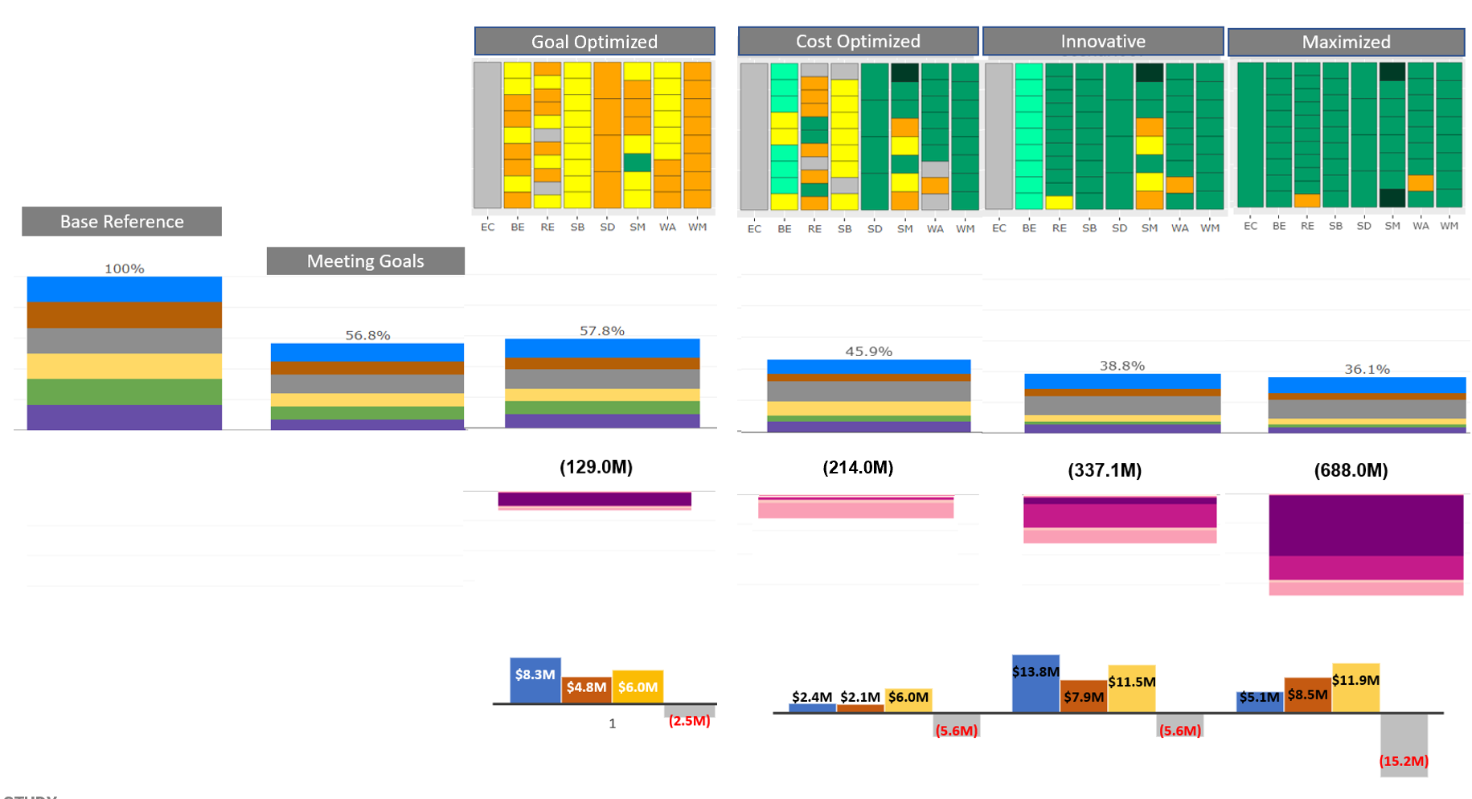
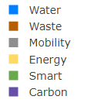
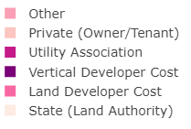
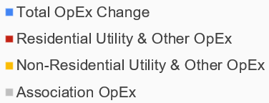
Scenario Comparison
Resource Footprint
Incremental CAPEX
Incremental OPEX

Slide 50
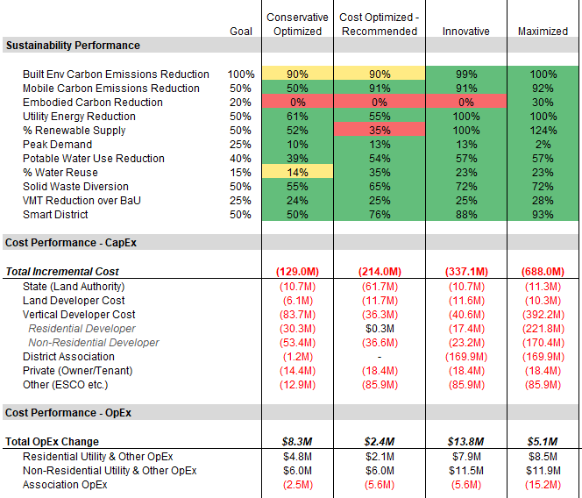
Scenario
Comparison
AECOM Recommended
Goal Optimized
Cost Optimized
Innovative
Maximized
A comparison of the scenarios shows two different approaches to optimizing performance and cost.
CapEx Cost Premiums
 | Goal Optimized | Cost Optimized | Innovative
Land Developer | +1.8% | +3.4% | +3.4%
Vertical Developer | +1.9% | +0.8% | +0.9%
Residential | +1.8% | +0.0% | +1.0%
Non-Res | +2.0% | +1.3% | +0.8%
Notes:
-The goal-optimized scenario is the simplest to implement with no district energy or community solar
-The cost optimized scenario keeps vertical developer costs and residual land value costs at practical levels w/o the unanswered questions about the utility association and governance model found in the Innovative program
-The Innovative scenario provides the most benefits but relies on more creative financing but provides more benefits
And our request is to explore the innovative option but we are able to pursue the Goal Optimized or Cost Optimized scenarios with more certainty at the moment
----
Under Cost Optimized Land authority cost comes largely from land value; but achieves the social benefits and objectives expressed by Utahns and our statute; serves as a model for smart growth; and additionally attracts the type of companies who we want at the site that help achieve the goal of being an economic catalyst – and as you all well know the economic benefits as laid out by GPI and revenues projected from the project provide really a monumental ROI for the state far greater than lease payments for the land

