Slide 1
Supplemental Studies: Implementation Roadmap
“The new community will foster innovation and technological advancement, provide parks and open space, support economic growth and enhance Utahns’ quality of life…we are committed to world-class sustainability measures such as a state-of-the-art air quality lab, charging stations for electric vehicles, self-automated shuttles and a seamless public transit system.”
Notes:
Thank you for the opportunity to present. We’ve been working on these studies for many months and are excited about the opportunity to make the aspirations of the point a reality.
Thank consultants
I recognize your time is valuable and limited. Which presents a challenge to summarizing these studies
Today what we want to accomplish is share the strategies our consultants have identified and which we feel best align with the framework plan goals, and the associated cost / benefit trade-offs.
I should note a critical dependency before selecting a final program is the selection of a master development partner / zions
And so our request is for your feedback as to whether we’re on the right track and your approval to continue additional analysis on how these strategies can be operationalized

Slide 2
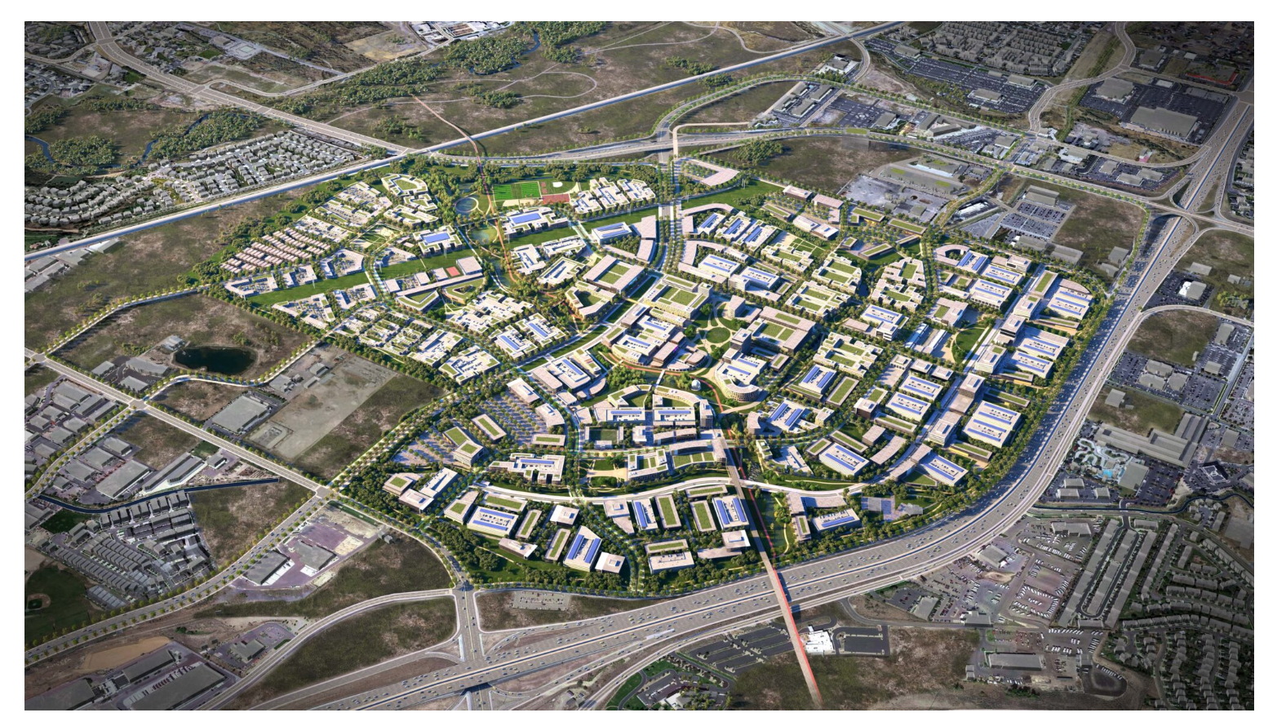
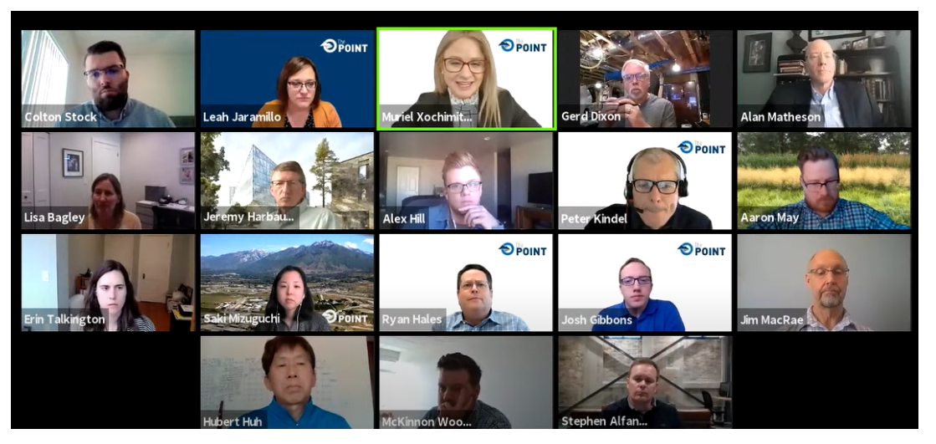
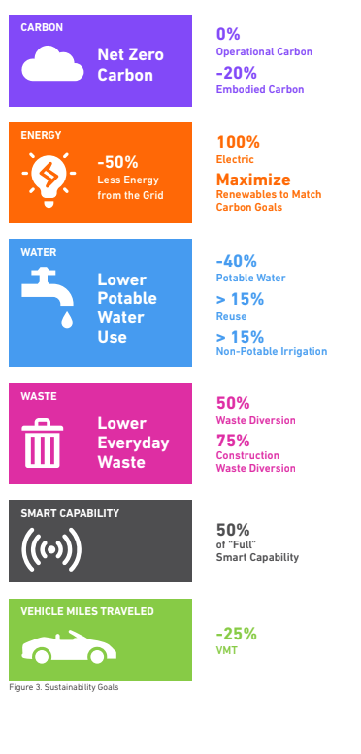
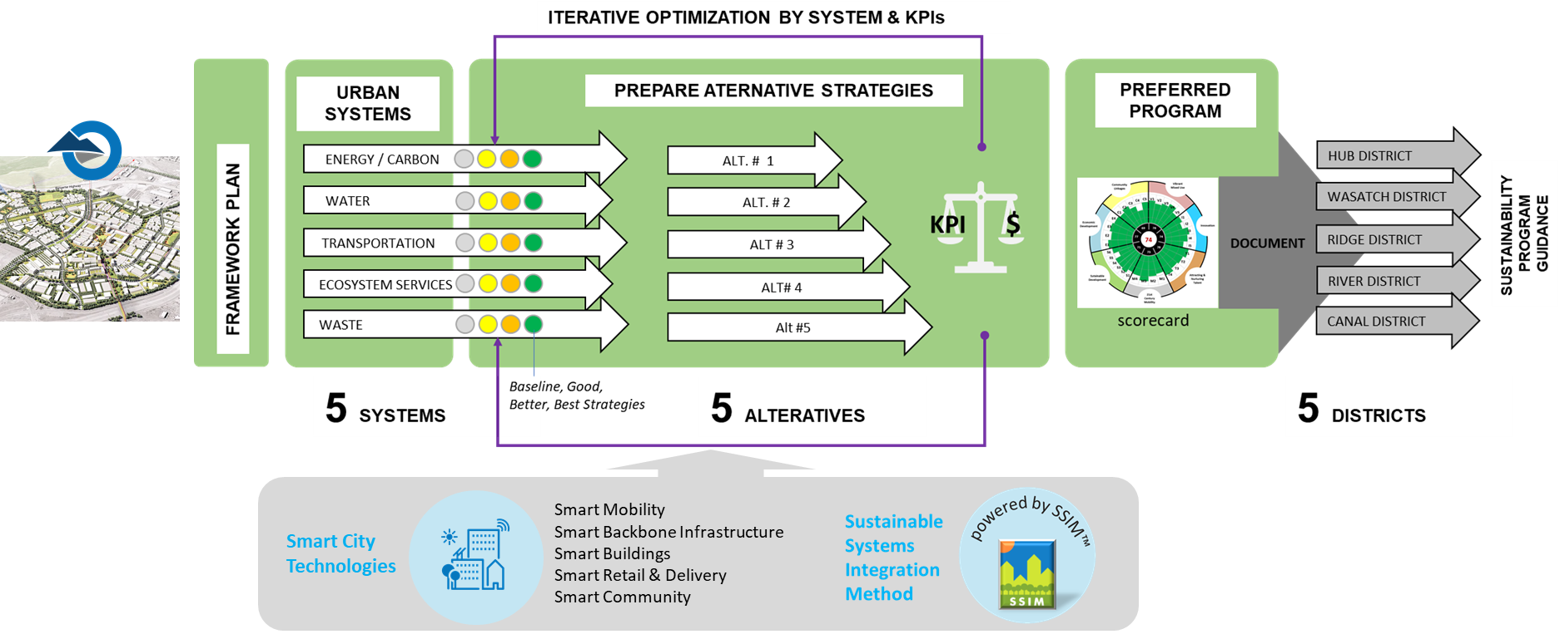
Visioning and Process
Robust Public Engagement
Working Groups - Community Leaders and Experts
World Class Framework Plan
Studies Based on Framework Plan Goals
Program Synthesis
Extensive Preliminary Reports
Notes:
As you know we have a mandate to be a model for smart growth and to deliver on what Utahns expressed they want with the land which belongs to them and those aspirations were captured in our framework plan and our statute.
These studies help us take a step further to making those ambitions a reality as they relate to smart mobility, sustainability and smart city technology.
KVE > Aspirations > Framework Goals

Slide 3
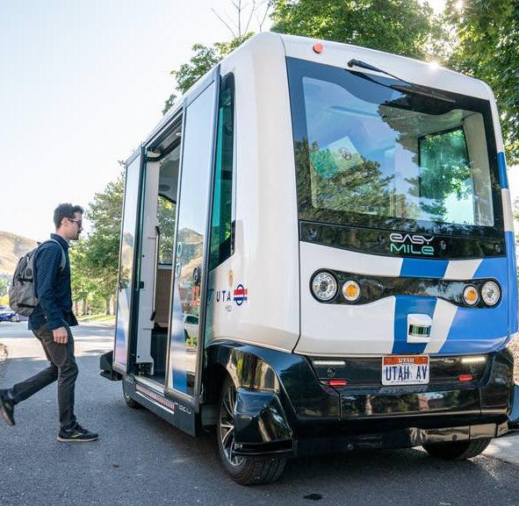
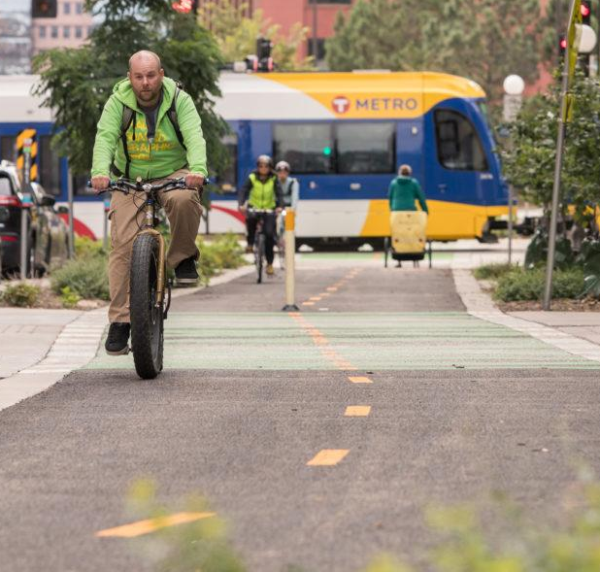
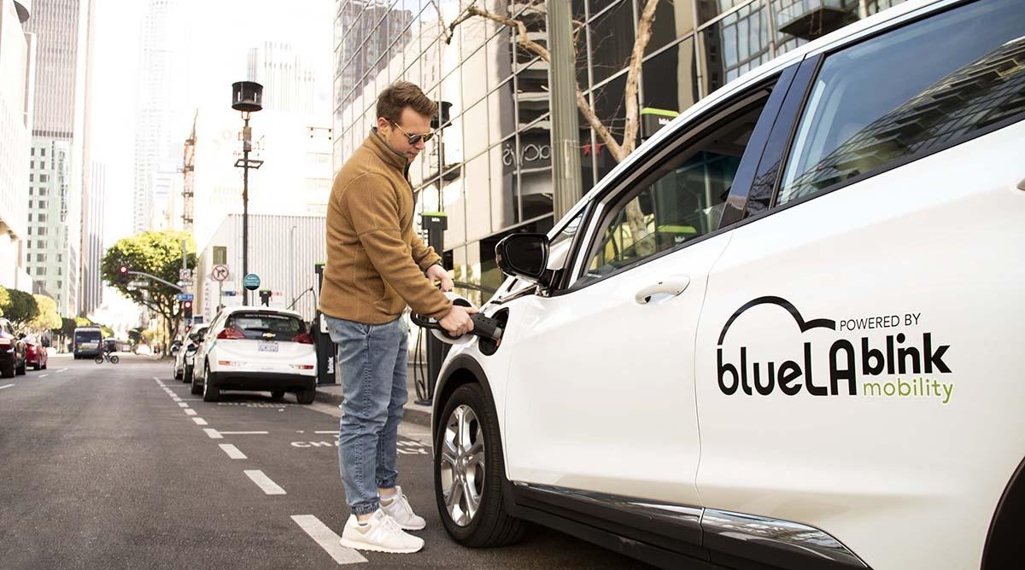
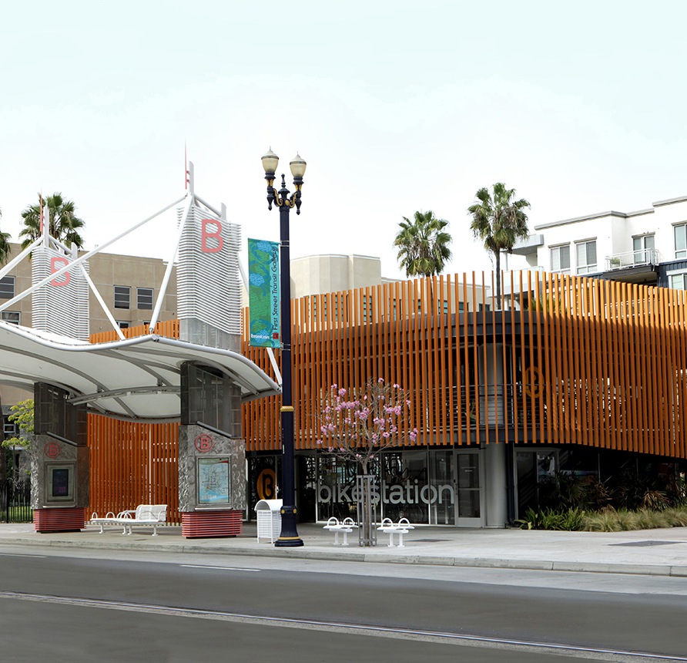
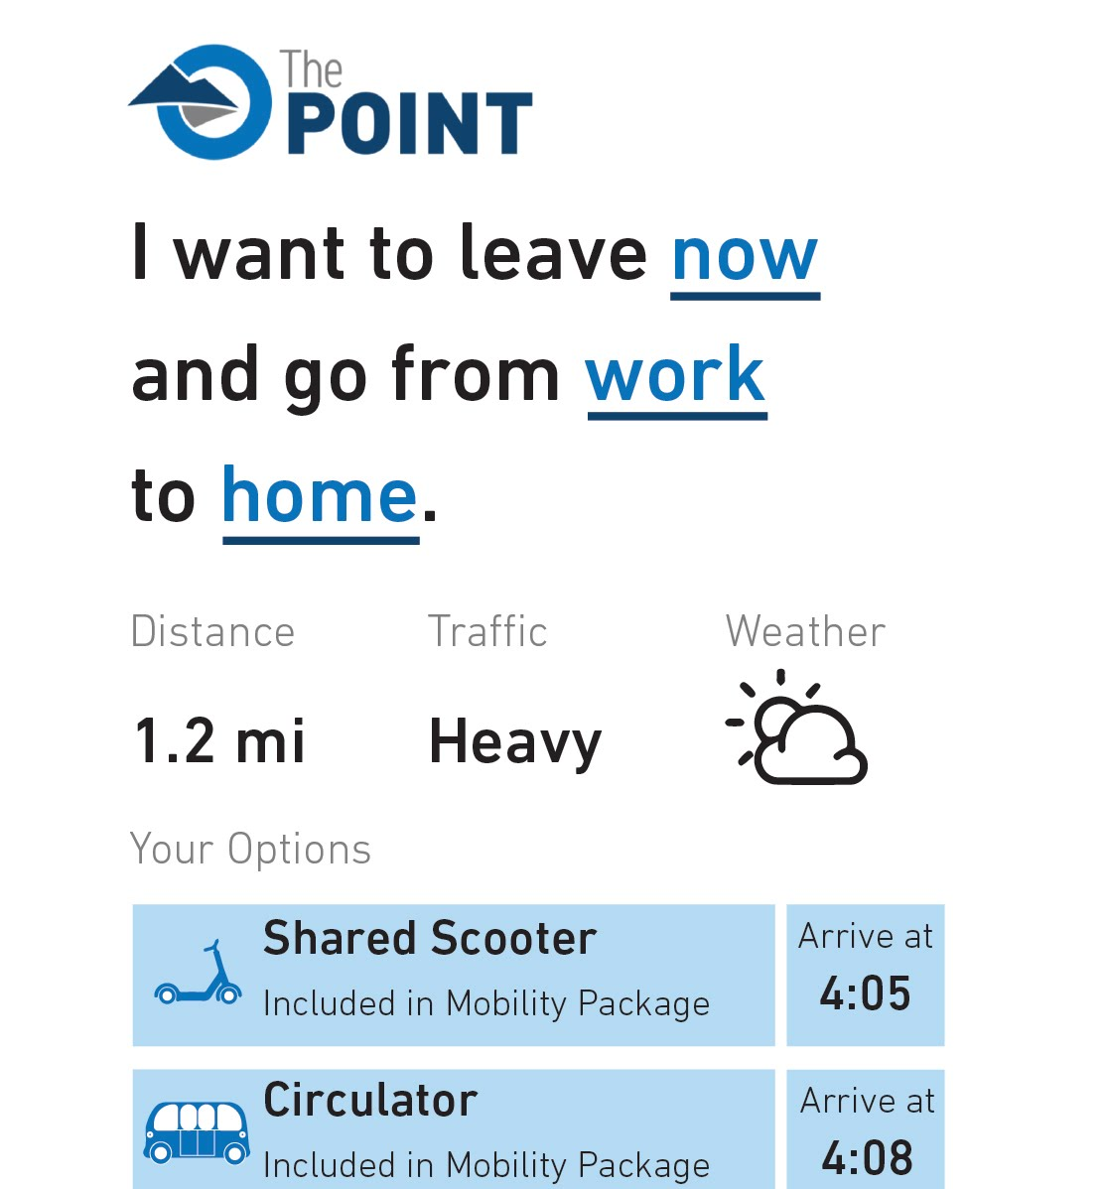
Smart Mobility Recommended Scenario
Circulator
Active Transportation + Micromobility
Car Share
Mobility Hubs
Mobility as a Service + Mobility Package
2.3-mile route connecting key destinations
12 vehicles serve stops every 5 minutes during peak periods and 10 minutes off-peak
Anticipate operating with a driver but preserving pathway to driverless operations as technology improves
Estimate 900 – 1,000 riders per day at full buildout
Fleet of 150 – 200 shared micromobility vehicles (i.e. electric scooters and bikes)
4 shared micromobility vehicles per 1,000 residents/employees
Combination of design and technology solutions to ensure comfort and safety for all users
Parking and charging standards for both personal and shared micromobility
Fleet of 100 – 120 shared, electric vehicles
16 car shares per 1,000 dwelling units
Mix of incentives and cost sharing to achieve 100% EV share
Shared cars located in parking facilities, designated on-street parking spaces, and at mobility hubs
Hubs at both BRT stations and in district cores enable connections between mobility options along with additional amenities
90% of the site is within a 5-minute walk of a larger (regional or district) hub
Microhubs located within public space at select circulator stops offer smaller set of amenities
App for planning, booking, and paying for trips across different transportation options
Discounted transit passes and free memberships for car share and shared micromobility for residents/employees
Monthly mobility credit applied to use of sustainable modes
Estimate >25% of residents/employees actively use program
Notes:
If you’re a resident or employee at the point your offered a suite of mobility options to achieve goals….
----
Circulator in 2 directions
Employees and residents and automatically enrolled, with free membership but a capped amount of free rides however there is a mobility credit – incentive to try out the system (someone who owns a car may be reluctant)

Slide 4
Strategies
Water
Baseline | Good | Better | Better+ | Best | Best +
Meets existing Code requirements | Water Efficient Fixtures (EPA WaterSense) Lawn to Water Efficient Landscape (Minimal) | Water Efficient Fixtures (EPA WaterSense) Lawn to Water Efficient Landscape (Moderate) Secondary Water for Irrigation (Partial) Rooftop Rainwater with Barrels | Water Efficient Fixtures (EPA WaterSense) Lawn to Water Efficient Landscape (Moderate) Secondary Water for Irrigation (100%) Rooftop Rainwater with Barrels | Water Efficient Fixtures (EPA WaterSense +) Lawn to Water Efficient Landscape (Aggressive) Secondary Water for Irrigation (100%) Rooftop Rainwater with Barrels | Water Efficient Fixtures (EPA WaterSense +) Lawn to Water Efficient Landscape (Aggressive) Secondary Water for Irrigation (100%) Secondary water for toilet flushing for NonRes Rooftop Rainwater with Barrels
Notes:
Circles are innovative program
Secondary Water for toilet flushing
Currently WaterPro is using blended Utah lake water with treated water which won’t work for toilet flushing for NonRes; also question over WaterPro water rights to use it for toilet flushing (JVWC treats the water but it’s supplied by WaterPro)

Slide 5
Strategies
Buildings: Energy
Building Types
Baseline | Good | Better | Better+ | Best
Meets existing Code requirements Commercial: IECC 2018 Residential: IECC 2015 Public realm LED lighting with basic controls | Meets next Code cycle requirements Improved building envelope Higher efficiency HVAC and service water heating More efficient lighting systems (fixtures & controls) LEED Gold 30% solar PV on rooftop areas | Electrification of building systems (heating, service hot water) Same envelope upgrades as Good Smart controls for Lighting in Public Realm LEED Gold/Platinum Up to 50% solar PV on rooftop areas | Electrification of building systems (heating, service hot water) High performance envelope (not passive) Smart controls for Lighting in Public Realm LEED Gold/Platinum Up to 50% solar PV on rooftop areas | Best in class performance (including triple glazing More efficient HVAC and lighting Smart controls for Lighting in public realm LEED Platinum +++ 50% solar PV on rooftop areas (community solar)
Apartment (Mid-Rise)
Hotel (Small)
Office (Large)
Office (Medium)
Retail (Standalone)
Retail (Ground Floor Retail)
School (Secondary)
Single-Family
Industrial
District Heating & Cooling
District Heating & Cooling
District Heating & Cooling
Notes:
Goal optimized has no Geo Thermal
Cost optimized has district Geo Thermal (ESCO)
Innovation optimized has district Geo Thermal (ESCO)

Slide 6
Strategies
Waste
Baseline | Good | Better | Best
Standard existing City of Draper Waste Management Practices | Waste Management Education Program Item Exchange/Donation Program Enhanced Recycling Systems (3-bin Waste Collection Systems) | Food Waste Recycle Program for Commercial Waste Management Education Program Item Exchange/Donation Program Enhanced Recycling Systems (3-bin Waste Collection Systems) | Pay-As-You-Throw Program Food Waste Recycle Program for Commercial and Residential Waste Management Education Program Item Exchange/Donation Program Enhanced Recycling Systems (3-bin Waste Collection Systems)
+
Smart Technologies for Refuse Collection
Notes:
Pay-as-you-throw (PAYT):
Customers/tenants are charged for waste disposal based on the amount generated rather than a flat-fee. There are two types of PAYT programs, by volume or by weight.
According to EPA, most communities charge residents by volume, using either bags or cans (or tags or stickers indicating specific can or bag sizes) as their program's unit of measure.
For example, the rate structure requires all trash to be placed in city-approved bags (i.e. $1 or $2 per bag depending on size) available for purchase at area retailers and other designated locations (i.e. city) .
Materials Exchange program
Develop or facilitate an online network to foster business-to-business connections to match unwanted material byproducts or commodities to opportunities for reuse or recycling as feedstock. e.g., computers, containers, furniture, office supplies, textiles, and surplus food.
Waste education – waste standards in leases, apt bldg. owner standards, community education,
3 Bin – waste, recycle, food/organics

Slide 7
Smart District
Smart Systems
Smart ICT Infrastructure
Conduits and Inner Duct Systems
Fiber Optic Cable Infrastructure
Wi-Fi Infrastructure
Passive Optical Network Infrastructure
Fiber meet-Me Rooms
Smart Community
Wastewater Monitoring System for Public Health
Smart Kiosks
Smart Refuse
Smart Community App
The Point OpenData
Community Smart Wall
Smart Environment
Air Quality Sensors
Sound Level Monitoring
Micro-Climate Sensors & Controls
Water Quality Monitoring
Smart Lighting
Tree Health Monitoring
Smart Mobility
Smart & Connected Intersections
Smart Parking
Circulator
Active Transportation + Micromobility
Car Share
Mobility Hubs
Mobility as a Service
EV Adoption
Smart Utilities
Centralized Energy Monitoring
Community Microgrid
Community Water Monitoring
Dynamic HPC (High Performance Compute) Optimization
Smart Buildings
Connected, Predictive, or Adaptive Building
Notes:
Community micro grid – which is a model that allows power in particular solar to be allocated across building in the community for more cost effective pricing and efficient service
EV – 3rd party to build and operate; 10k w/ 2/3 in offices
HPC – micro data center that allows for cost effective dynamic demand power mgmt. at the site, including load banking as a revenue stream to avoid demand charges and optimize return on solar

Slide 8
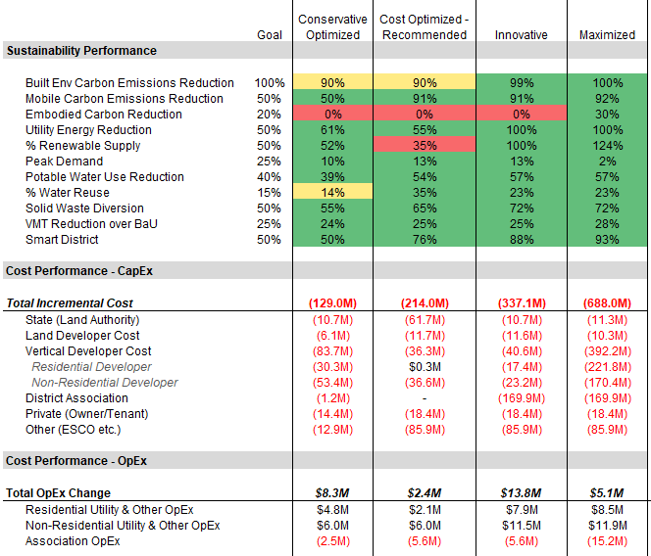
Program Scenario Comparison
Recommended
1
2
3
Maximized
CapEx Cost Premiums
 | 1 | 2 | 3
Land Developer | +1.8% | +3.4% | +3.4%
Vertical Developer | +1.9% | +0.8% | +0.9%
Residential | +1.8% | +0.0% | +1.0%
Non-Res | +2.0% | +1.3% | +0.8%
Directional Figures
Notes:
-The goal-optimized scenario is the simplest to implement with no district energy or community solar
-The cost optimized scenario keeps vertical developer costs and residual land value costs at practical levels w/o the unanswered questions about the utility association and governance model found in the Innovative program
-The Innovative scenario provides the most benefits but relies on more creative financing but provides more benefits
And our request is to explore the innovative option but we are able to pursue the Goal Optimized or Cost Optimized scenarios with more certainty at the moment
----
Under Cost Optimized Land authority cost comes largely from land value; but achieves the social benefits and objectives expressed by Utahns and our statute; serves as a model for smart growth; and additionally attracts the type of companies who we want at the site that help achieve the goal of being an economic catalyst – and as you all well know the economic benefits as laid out by GPI and revenues projected from the project provide really a monumental ROI for the state far greater than lease payments for the land

Slide 9
The Supplemental Studies Identified the Strategies to Deliver on POMSLA’s Goals
Recommended Strategies
Smart Mobility
Smart City Tech.
Sustainability
Geothermal District Energy
Community Solar
Efficient Building Envelopes
Smart Fixtures
Water Capture/Reuse
Waste Programs
Smart ICT Infrastructure
Smart Environment
Smart Utilities
Smart Community
Smart Buildings
Smart Mobility Additions
Circulator
Active Transportation & Micro-mobility
Car Share
Mobility Hubs
Maas & Mobility Package
Funding/
Delivery Models
Additional Analysis Needed
Public Financing
Infrastructure Bank
Developer Investment
P3 - ESCO
Utility District
To Achieve POMSLA Statute Duties
“promote a high quality of life for residents on and surrounding the point of the mountain state land”
“improve air quality and minimize resource use”
“protect the environment”
“ensure strategic residential and commercial growth”
Zero Carbon Community
50% Renewables / 50% Reduced Energy Consumption from Grid
-40% Potable water / >15% Reuse / 100% Non-potable Irrigation
50% Waste Diversion
50% Smart Capability
-25% Vehicle Miles Travelled
Utah Code 11-59-203
Framework Plan & Supplemental Studies

Slide 10
How do we Operationalize the Strategies
Proposed Enhancement Programs
Implementation Dimensions
Example Key Questions
Legal / Regulatory
Financial
Governance / Operational
Technical
1 - Legal / Regulatory
What is allowed (i.e.,ESCO, Utility District)?
What are the barriers?
What can be changed?
2 - Financial
Who will pay for what?
Is it economically viable?
How do state/master dev participate?
3 - Governance / Operational
Who will be responsible for DBFOM?
How will it be structured organizationally?
What of privacy, security, reporting, etc.?
4 - Technical
Are all use cases feasible?
Who are the vendors?
What are the barriers / risks?
Sustainability
Smart City Tech.
Proof of Model Sequence
Smart Mobility
POMSLA’s Mandate -> Supplemental Studies -> Social & Economic Benefits

Slide 11
Focused Next Steps – “Prove the Model”
Priority Next Step
Secondary Next Step
Proposed Enhancement Programs
Implementation Dimensions
Example Key Questions
High impact issues and key to achieving goals
Legal / Regulatory
Financial
Governance / Operational
Technical
Utility District
ESCO
Community Solar
Geothermal
1 - Legal / Regulatory
What is allowed (i.e.,ESCO, Utility District)?
What are the barriers?
What can be changed?
2 - Financial
Who will pay for what?
Is it economically viable?
How do state/master dev participate?
3 - Governance / Operational
Who will be responsible for DBFOM?
How will it be structured organizationally?
What of privacy, security, reporting, etc.?
4 - Technical
Are all use cases feasible?
Who are the vendors?
What are the barriers / risks?
Sustainability
Smart City Tech.
Proof of Model Sequence
Smart Mobility
POMSLA’s Mandate -> Supplemental Studies -> Social & Economic Benefits

Slide 12
Implementation Plan
Regulatory/Legal
Financial
Governance / Operations
Technical
Establish working group to “Prove Concept”
Identify barriers and opportunities
Negotiate / seek input from Utilities and other stakeholders
Create recommended action plan
Initiate regulatory / statute changes
Refresh financial model with new assumptions
Identify grant opportunities
Update with optimal financing strategy outputs
Alternatives model refresh
Present plan to Board and Master Developer
Development agreement negotiation
Identify association structure(s)
Develop operating model
Roles and responsibilities
Charters, legal authorities and certifications
Upfront and on-going cost analysis
Risks and mitigants
Privacy, security, stakeholder assessment and plan
Issue RFQs for vendor services
Identify risks and mitigants
Collaborate with stakeholders (Master Dev)
Integration planning
Design and development
Contract award / negotiation
Delivery of services
Operations, monetization, reporting
Note: Steps are not exhaustive and dimensions may overlap and not necessarily proceed linearly

Slide 13
Focused Working Group to “Prove the Concept”
Stakeholders
Working Group
Existing Resources
Focus is on Utility Association, ESCO, Geothermal and Community Solar
RMP / Utility Cos.
The Point
MIB Partners
AECOM
Local Developers
RCLCO
Master Developer
Advisors
Vendors
Zions Public Finance
Outputs
~6 week timeframe
Assessment of Legal Constraints & Opportunities
Updated Financial Output to Propose to Master Developer
Action Plan (e.g., statute changes, RMP negotiating points, etc.)

Slide 14
Implementation Plan Roadmap
Apr | May | Jun | Jul | Aug | Sep | Oct | Nov | Dec | Jan | Feb | Mar | Apr | May | Jun | Jul | Aug | Sep | Oct
Conceptual
Master
Plans
Master
Developer
Awarded
Development Agreement
Executed
Site Plan
SD/DD/CD
Completed
Conceptual Building Designs Completed
Stand-up Working Group
Backbone
SD/DD/CD
Completed
Backbone
Construction
Begins
Primary Horizontal Needs
Proof of Model
Financial Rev
Refined
Governance / Operational Plan
Technical Analysis & Negotiations
The Roadmap ties key decisions to corresponding relevant milestones (e.g., legal/financial viability and responsibilities understood before contracts in place and designs substantially advanced)
Secondary Horizontal Needs
Expansion of Model
Financial Refresh / Refinement
Governance / Operational Plan
Technical Analysis & Negotiations
Vertical Needs
Expansion of Model
Note: Working Schedule is subject to change
Financial Refresh / Refinement
Governance / Operational Plan
Board Reviews
Technical Analysis & Negotiations

