Slide 1
Iconic Feature Design Process Concept 6/14/22

Slide 2
An Iconic Feature at The Point
Public Engagement
Project Stakeholders
The Right Fit
World-class Designers
Framework Plan
Known Globally
Cost
Scale
Loved Locally
We are currently developing a process for the design of an iconic feature(s) at The Point. It is our understanding that the Governor would like us to think big. We believe the feature(s) for Utah’s Innovation Community will need to be distinctive and world-class.
Iconic
Notes:
In collaboration with our design experts (Steve, SOM) and our communications team (x-factor)

Slide 3
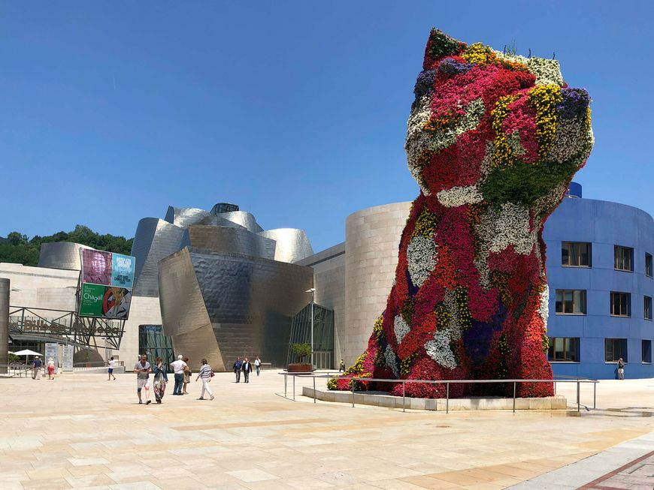
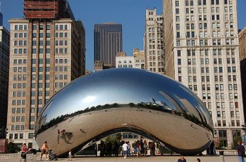
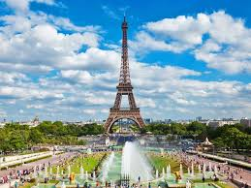
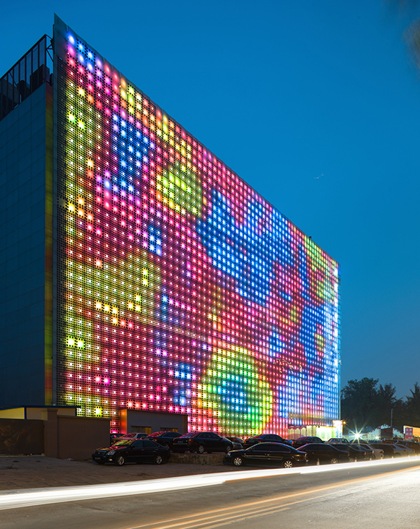
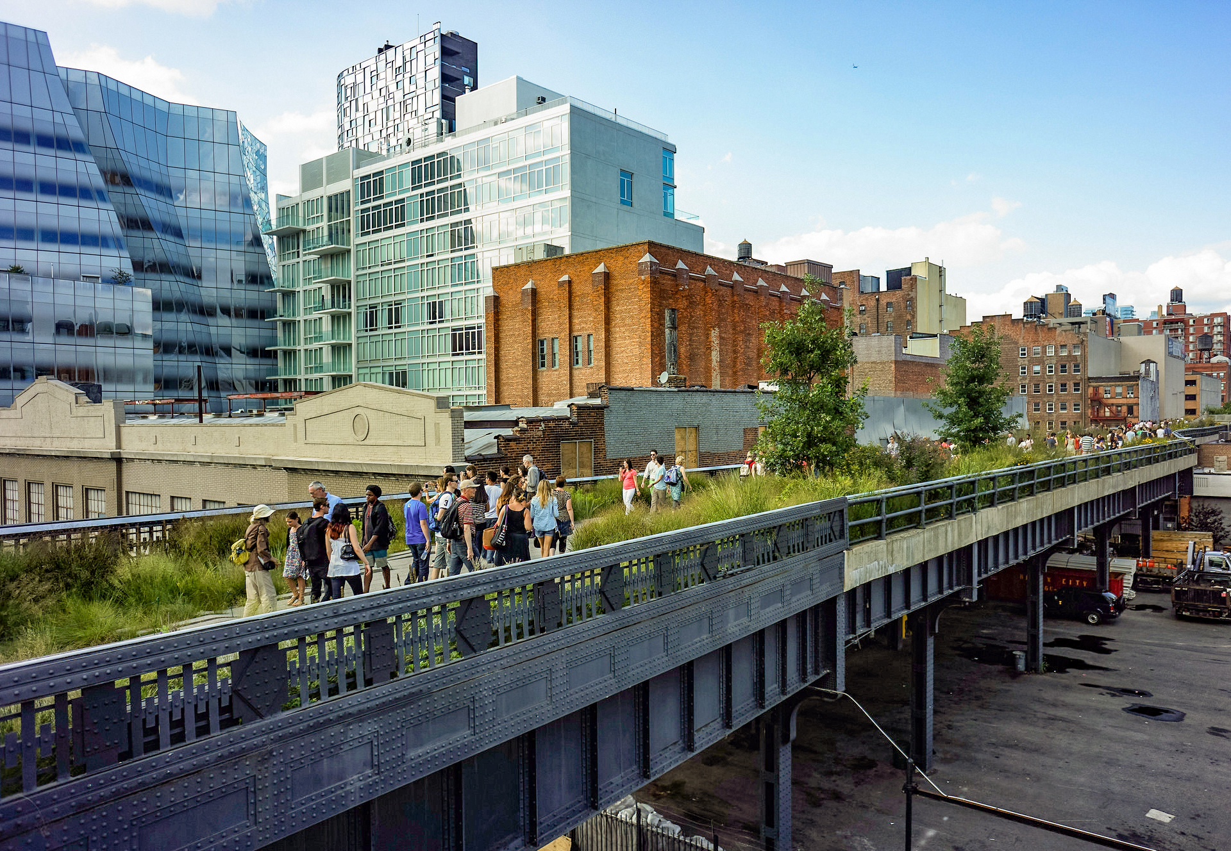
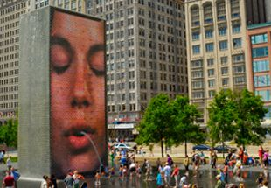
Example Iconic Features Around the Globe
Architectural Structure
Sculpture
Eifel Tower - Paris
Gherkin Tower - London
The Puppy - Bilbao, Spain
The Bean - Chicago
Landscape Art
Water Feature
Digital Art
Highline - New York
The Crown Fountain- Millennium Park
Media Wall - Beijing

Slide 4
Visual Preference Survey
Results Analysis
Engage Professional Designers
Plan to Build Feature
Master Plan Design Coordination
Professional Design Stage
Selection of Iconic Feature
Conceptual Design Process
Survey Format
Public Engagement
Themes and Scope/Scale
Location
Designs
Analyze Data
Compile Results
Package for Professionals
Determine Budgets
Initiate RFP Process
Select Participants
Public Relations
Identify R2R Considerations
Identify Central Park Considerations
Identify Phase 1 / Sub-campus considerations
Stand-up DRB
Initiate Design Competition
Public Relations
DRB Reviews
Stakeholder Touch Points
Submissions
Schedule/cost reviews
Public Input
Scoring and Selection
Award
Public Relations
Stakeholder Integration
Process Development
Quality Assurance
Design Review Board Oversight
Qualified Expertise
Public Engagement
Public Re-engagement
Board Approval
Board Approval
Board Approval

